Slide 1
IEC TC57 WG19
CIM – 61850 Harmonization
Work in progress.
For discussion
Tom Berry
TF Convenor
tom.berry@se.com
Date: September 2022
Location: Minneapolis + remote

Slide 2
Agenda
IEC 62361-102 Ed 2 document status
Ed 1 recommendations status & decisions
Ed 2 new recommendations
CIM to SCL and CIM protection model use cases - Key concepts

Slide 3
IEC 62361-102 CIM – 61850 Harmonization
Ed 1 published 2018
Ed 2 DC circulated May 2020
  Aim is to align with IEC 61970-301 Ed 7 (CIM 17), IEC 61850 Ed 2.1, IEC 61850-7-420 Ed 2
DC has been incorporated into a CD but not circulated
  Main issue: difficult to make a recommendation for mapping DER controller equipment and functions within CIM
Current work is via WG13 Sub-group(s) for CIM
  Individual DER control functions (as per IEEE 1547)
  User defined functions to model DER aggregation, coordinated voltage control, ...

Slide 4
Compared to the first edition, this second edition:
Describes some use cases for voltage control including the integration of Distributed Energy Resources (DER), and proposes mappings and recommendations for the models defined in IEC 61850-7-420:2021 Ed 2.
Includes revisions for consistency with IEC 61970-301:2020 Ed 7 (CIM17)
Includes revisions for consistency with IEC 61850-7-4:2021 Ed 2.1
Adds relevant Logical Nodes from IEC 61850-7-410:2012/AMD1:2015
Adds relevant Logical Nodes from IEC 61850-90-6:2018 Distribution Automation
tbc relevant Logical Nodes from IEC 61850-90-3:2016 Condition Monitoring
Excludes Logical Nodes (no equivalent in CIM)
  IEC 61850-90-4 Network Engineering
  IEC 61850-90-8 E-Mobility
  IEC 61850-90-17 Power Quality
  IEC 61400-25-2 Wind power plants

Slide 5
Recommendations – Joint task forces
R11: Create a joint task force to produce a document defining drawing layout syntax using technology similar to Scalable Vector Graphics (SVG) to replace the X, Y coordinate/graphics in both IEC 61850 and CIM.
  No work done : application areas are not necessarily the same
R20: The relevant working groups and task forces should coordinate to propose harmonized models and mappings for automated control sequences.
  IEC 61850-90-11 defines mappings between PLC logic and IEC 61850
  Under consideration by TC 57 WG13 CIM Functions subgroup

Slide 6
Recommendations planned for IEC 61850 Ed 3
R2: Extend the list of equipment device type codes
R3: Add optional string attribute tPowerSystemResource.psrtype
R6: Add mRIDs for Equipment, Terminals and ConnectivityNodes.
R8: When Terminals are not connected, keep the Terminal, make connectivityNode optional
R9: extend the existing tPhaseEnum to use the same enumerations as the CIM PhaseCode.
R15: add a setting called PosFlwIn, to the Measurement logical nodes, to indicate the direction of positive flow relative to the primary equipment connectivity
New from IEC 61850-7-420 Ed2 / IEC 62361-102 Ed2
R31 : add a standard type code "INV" with one terminal, that can be used for conducting equipment that is a power electronics connection (inverter or rectifier).

Slide 7
Recommendations for CIM from Ed1
Ref | Topic | Status June 2020 | Status Sep 2022
R4 | BusbarSection and Junction | Agreed improved description | IEC 61970-301 Ed 7
R10 | Phase code enumerations | Agreed to clarify the descriptions | IEC 61970-301 Ed 7
R16 | Definition for Analog.positiveflowin | Agreed improved description | IEC 61970-301 Ed 7
R7 | Name types for SCL | Rejected because the CIM has changed | To update IEC 62361-102 Ed2
R13 | Use selected IEC 61850 data object names as MeasurementTypes | Part of Measurements discussion | On hold
R14 | OR New attribute for IEC 61850 data object names | Part of Measurements discussion | On hold
R17 | Multiple values with same timestamp and quality, e.g. WYE | Part of Measurements discussion | On hold (probably no)
R12 | SCADA package revisions – allow direct association IED to MeasurementValue | Add to a future WG13 meeting | On hold
R18 | Improve control model | Add to SCADA discussion | On hold
R19 | Define standard Control Types | Add to SCADA discussion | On hold
R20 | Automated control sequences (SIPS) | DER Controllers & Functions discussion | WG13 Function subgroup
R5 | Fans and pumps | If there are use cases, then add to CIM18 | On hold (probably no)
R21 | Re-evaluate the CIM Protection Model | To be revisited | WG13 taskforce (linked with functions)

Slide 8
Recommendations for CIM – new from draft Ed 2
Ref | Topic | Status September 2020
R32 | Model DER internal states e.g. ready to connect | To reconsider based on CIM functions proposals
R33 | Extend regulating control model – add curve | To reconsider based on CIM functions proposals
R34 | Extend control model for active power operational functions | To reconsider based on CIM functions proposals
R35 | Modelling of facilities and virtual power plants, including different representations of the same physical equipment. | To reconsider based on CIM functions proposals
R36 | the association(s) between the Metering classes defined in IEC 61968-5 and the Core and Wires classes used for network analysis. | Add UsagePoint -> Terminal association CIM Joint Issue to be discussed 19-Sep-2022
R37 | add class ReactivePowerLimit as a sub-class of OperationalLimit | To add to work plan

Slide 9
IEC 61850 – CIM Harmonization: Long term
R1 Export CIM as System Specification Document (SSD)
  Objective: allow CIM to be used to specify & record automation functions
  Linked with
R21 review the CIM Protection model
  Objective: re-design the CIM protection model based upon the newer concepts of protection functions instead of protection equipment.
  May facilitate incorporation of requirements for System Integrity Protection Schemes (SIPS).
  See also “A proposal of new classes representing protection relay functions”, Takashi Dozaki, Tetsuo Otani, 15-Dec-2021
  To be further discussed by WG13 22-Sep-2022

Slide 10
Concepts
An automation scheme is a generalization of
  Protection Scheme
  Voltage control scheme
  DER Coordinated control
  Etc, etc
Automation schemes use predefined functions and user defined functions
Pre-defined (built-in) functions will be defined by classes for
  Protection functions
  Regulating control functions
  Logic functions
  Grid interface functions
  …
Functions are hosted by one or more physical devices

Slide 11
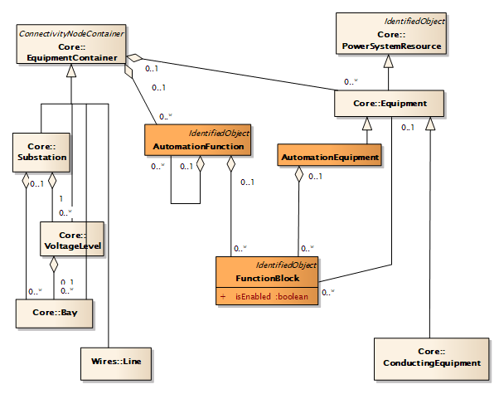
CIM to System Specification Description add AutomationFunction and FunctionBlock
Proposal
System Specification Description (SSD) includes:
the single line description, identifying the equipment
[high level] AutomationFunction
associated Logical Nodes = FunctionBlock
After design and installation, the functions are hosted in AutomationEquipment
A type of asset probably with communication capability

Slide 12
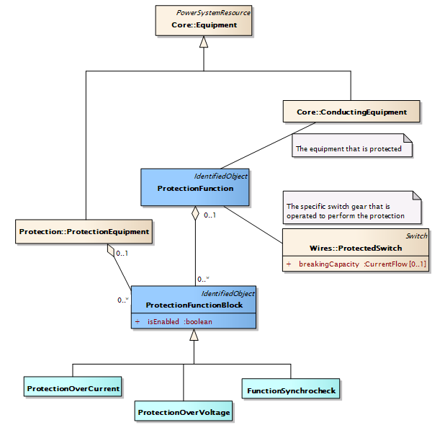
Protection
ProtectionFunction = Scheme ProtectionEquipment
Proposal
ProtectionFunction = the logical view
ProtectionFunctionBlock = a specific function or stage
ProtectionEquipment = the physical view
  No explicit associations to the protected equipment or switches

Slide 13
Questions?
How much of the CIM function model proposals should be in IEC 62361-102 Ed 2 before circulation as a CD?
  With the details, maybe as an annex?
  As a summary with reference to a proposed new TR that has details?

