Slide 1
IEC TC57 WG19
CIM – 61850 Harmonization
Functions and Protection
(high level view)
Work in progress.
For discussion
Tom Berry
TF Convenor
tom.berry@se.com
Date: March 2022
Location:

Slide 2
IEC 61850 – CIM Harmonization: Use cases
R1 Export CIM as System Specification Document (SSD)
  Objective: allow CIM to be used to specify & record automation functions
R21 review the CIM Protection model
  Objective: re-design the CIM protection model based upon the newer concepts of protection functions instead of protection equipment.
  May facilitate incorporation of requirements for System Integrity Protection Schemes (SIPS).
  See also “A proposal of new classes representing protection relay functions”, Takashi Dozaki, Tetsuo Otani, 15-Dec-2021

Slide 3
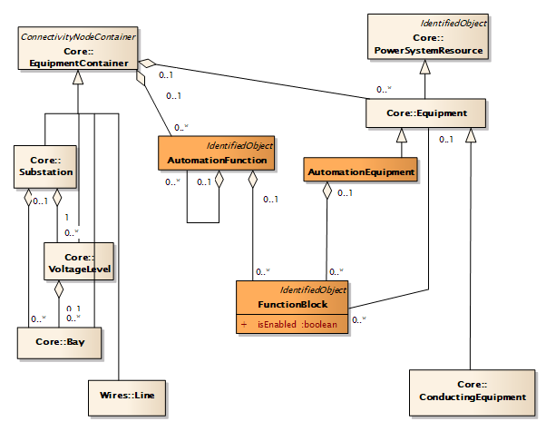
CIM to System Specification Description add AutomationFunction and FunctionBlock
Proposal
System Specification Description (SSD) includes:
the single line description, identifying the equipment
[high level] AutomationFunction
associated Logical Nodes = FunctionBlock
After design and installation, the functions are hosted in AutomationEquipment
A type of asset probably with communication capability

Slide 4
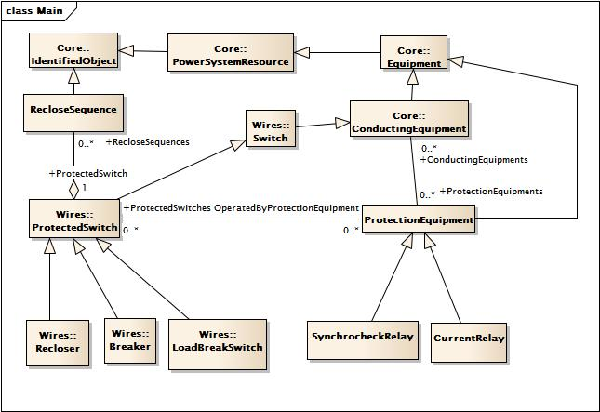
Protection
CIM17 model
Existing
ProtectionEquipment and xxRelay is a physical asset-oriented view
Modern practice (TC95, IEC 61850) is to have a functional view

Slide 5
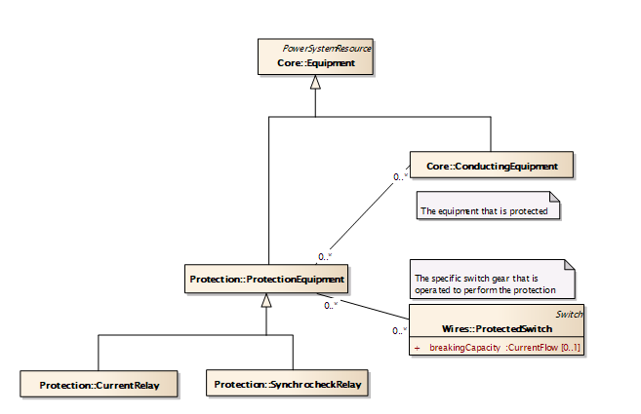
Protection
Fundamental
Existing
ProtectionEquipment has two relationships that should be consistent
Logical
  the equipment that is protected.
  specification view
  bus-branch view
Physical
  the breakers or switches that are operated

Slide 6
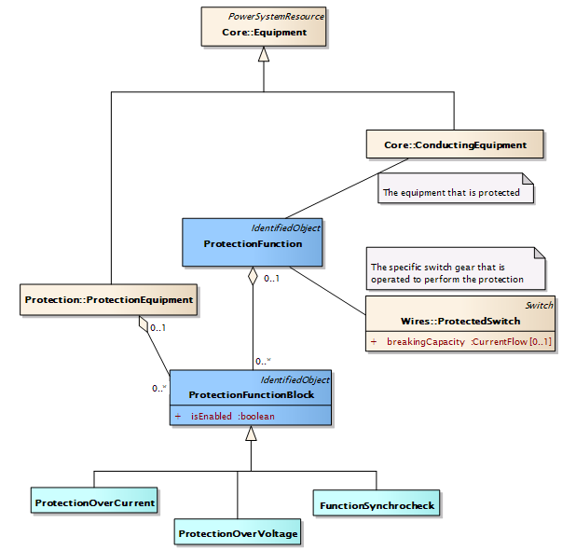
Protection
Add ProtectionFunction and ProtectionEquipment
Proposal
ProtectionFunction = the logical view
ProtectionFunctionBlock = a specific function or stage
ProtectionEquipment = the physical view
  No explicit associations to the protected equipment or switches

Slide 7
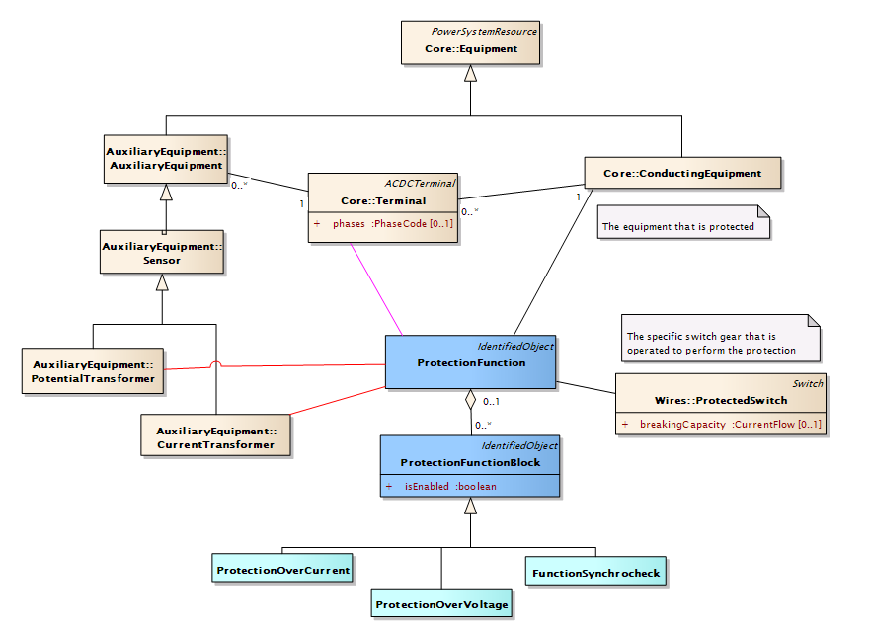
Protection link to Terminal / CT, VT
Implied by equipment
Explicit to Terminal(s)
Explicit to CT, VT

Slide 8
Questions …
How useful is it to distinguish between Automation and Protection Equipment?
How useful is it to distinguish between Automation and Protection Functions?

