Slide 1
CIM Controls Modelling Issues
Tom Berry
10 June 2025

Slide 2
Agenda
Controls
…

Slide 3
https://redmine.ucaiug.org/issues/6610
Multiple issue Measurement and Control
Added by Svein Olsen over 1 year ago. Updated 8 months ago.
Description
This is a collection of issues on CIM17 Measurement, SCADA and Control information model with the focus on what is relevant for the Operation profile.
Decision
16-Sep-2024 Joint TF Hybrid Meeting - Minneapolis:
Reviewed together.
Action Item: Alex and Tom to check the issues and see what are low hanging fruits that can be easily fixed and which of the items will be followed up in the new TF subteam on the topic and which issues are to be assigned to CIM19:

Slide 4
Issue category
#5976 Better model for discrete raise/lower commands for tap position
Setpoint class should support timed power envelope limits

Slide 5
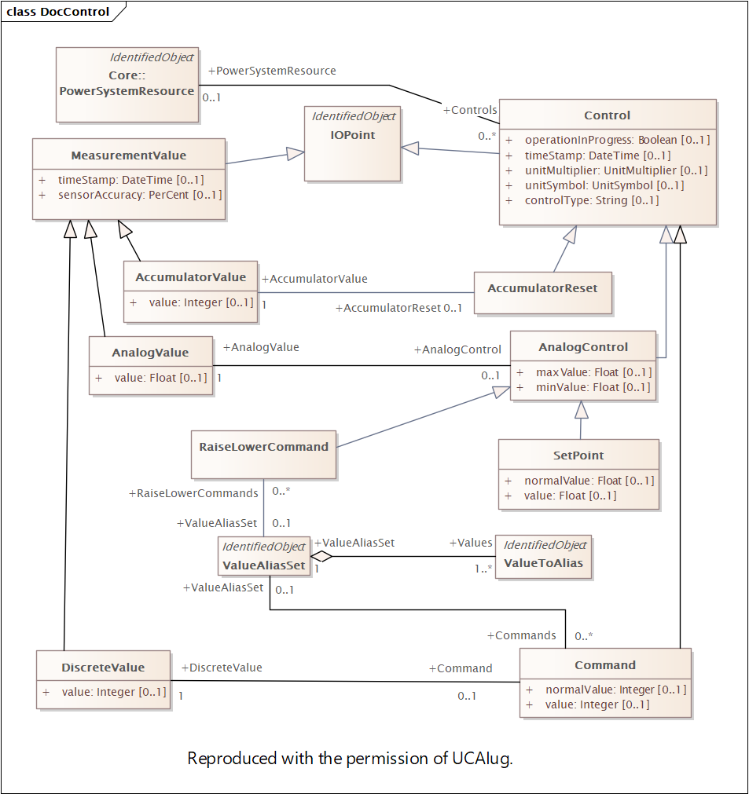
Control Type
Similar to MeasurementType
Except CIM documents don’t list any strings
And many (most?, all?) controls are associated with a measurement which has its own type.
To be revised to use same design pattern as Measurement / MeasurementValue
Control = static information
ControlValue = dynamic
…

Slide 6
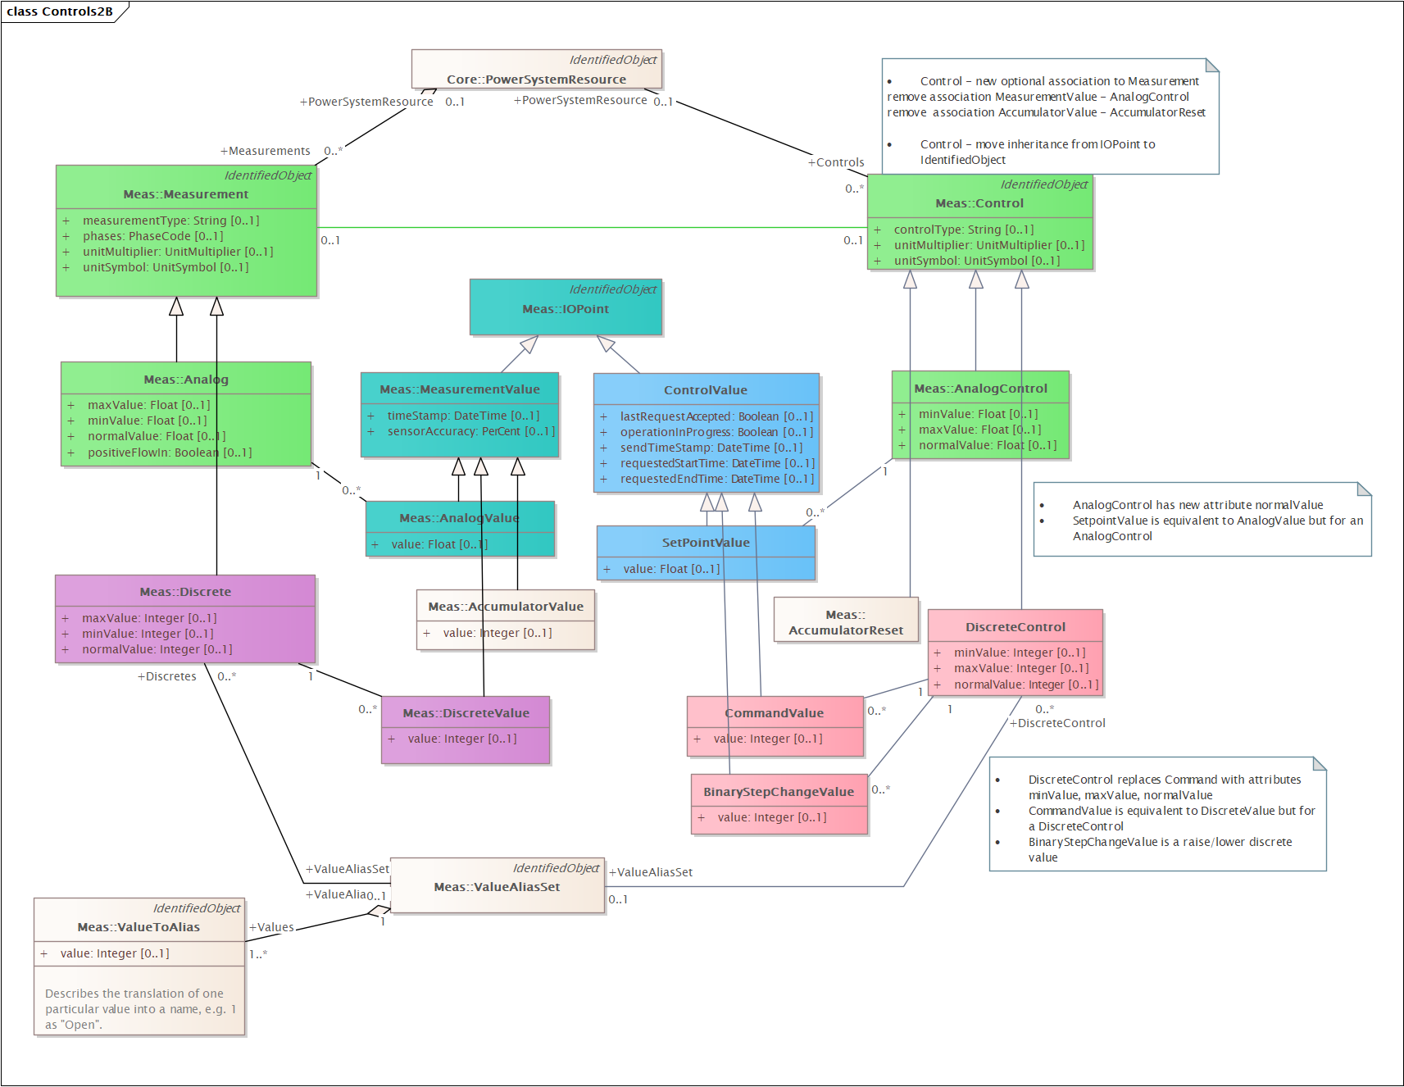
Controls
Similar design pattern for controls as for measurements
Adds optional static association between Control and Measurement
Remove associations for Value classes

Slide 7
To do
Review link(s) to Supervisory:RemoteControl
Discussion point: re: raise/lower or open/close commands
Should CIM model support binary controls mapped to two remote points or is this is internal to a SCADA system?
Propose a “ControlOrigin” class with similar purpose to “MeasurementSource”
Category : control center, application, automation system, field, ..
…

Slide 8
Thank you
Questions?

