Slide 1
CIM Measurement Modelling Issues
Tom Berry
5 June 2025

Slide 2
Agenda
Issue categories
Measurement Type
Measurement Source
…

Slide 3
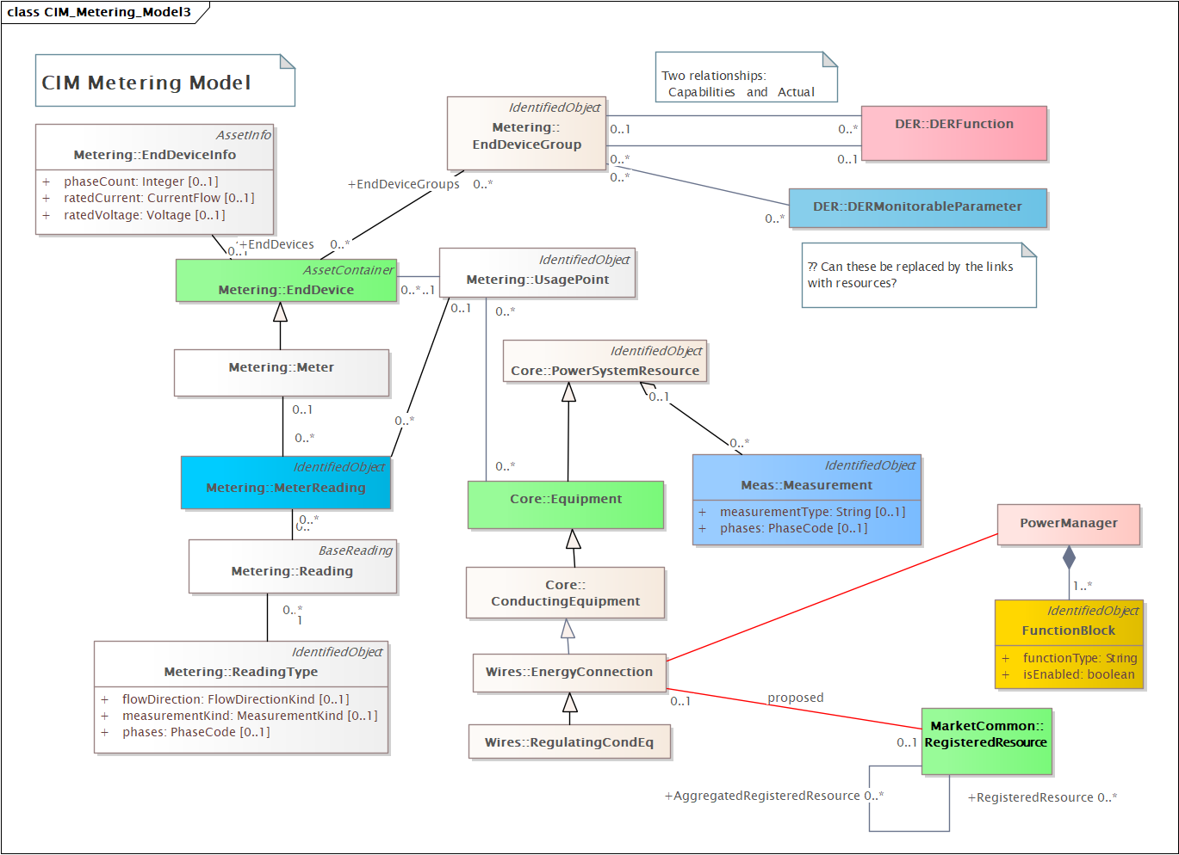
Measurement, MeterReading, MonitorableParameter
From
13 March 2025
= alternative ways of collecting data
Needs more thought and discussion …

Slide 4
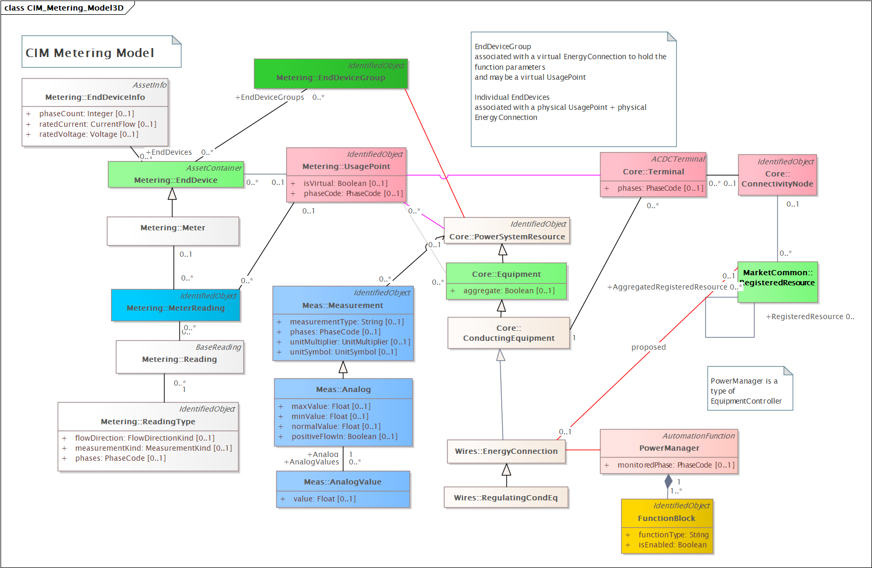
Link by UsagePoint = Terminal = ConnectivityNode
Showing
MeterReading
plus
Measurement

Slide 5
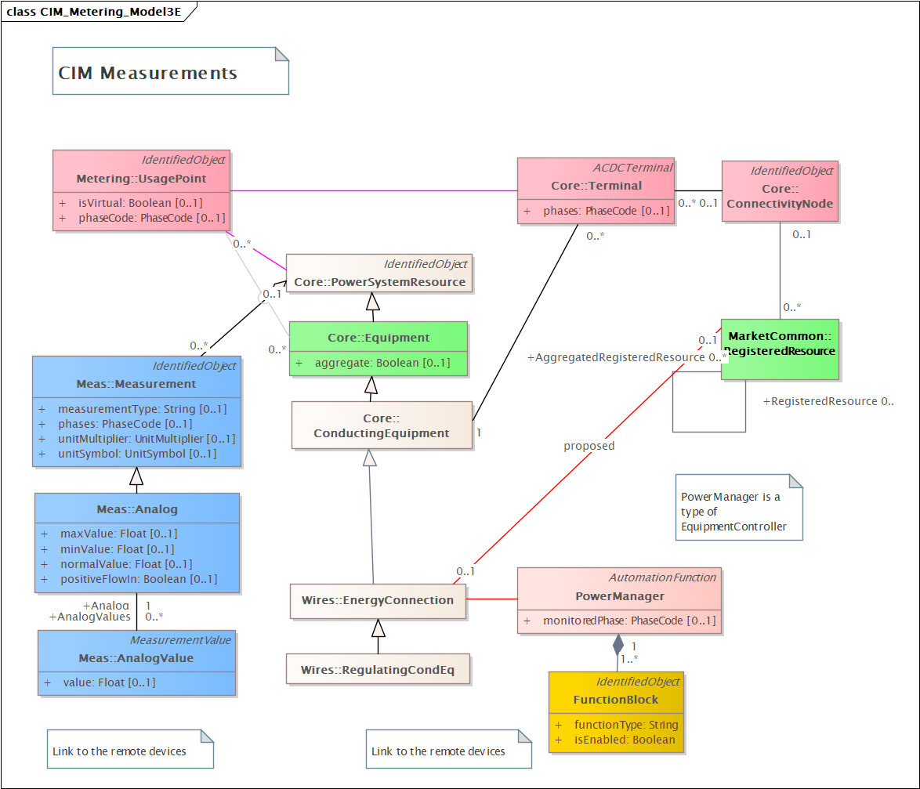
Concentrate on Measurements
Showing
Measurement

Slide 6
https://redmine.ucaiug.org/issues/6610
Multiple issue Measurement and Control
Added by Svein Olsen over 1 year ago. Updated 8 months ago.
Description
This is a collection of issues on CIM17 Measurement, SCADA and Control information model with the focus on what is relevant for the Operation profile.
Decision
16-Sep-2024 Joint TF Hybrid Meeting - Minneapolis:
Reviewed together.
Action Item: Alex and Tom to check the issues and see what are low hanging fruits that can be easily fixed and which of the items will be followed up in the new TF subteam on the topic and which issues are to be assigned to CIM19:

Slide 7
Issue categories
#5972 Measurement Type naming conventions
#5975 Control Type - new attribute and naming convention
Measurement source
#6736 Corrections for Quality61850 - done
New setpoint class for timed power envelope limits
#5976 Better model for discrete raise/lower commands for tap position
#5973 New classes for three times single phase values (WYE or DEL)
Communications related
Internet (VPN) connections direct to automation equipment (IEC 61850, …)
Better model for redundant comms links

Slide 8
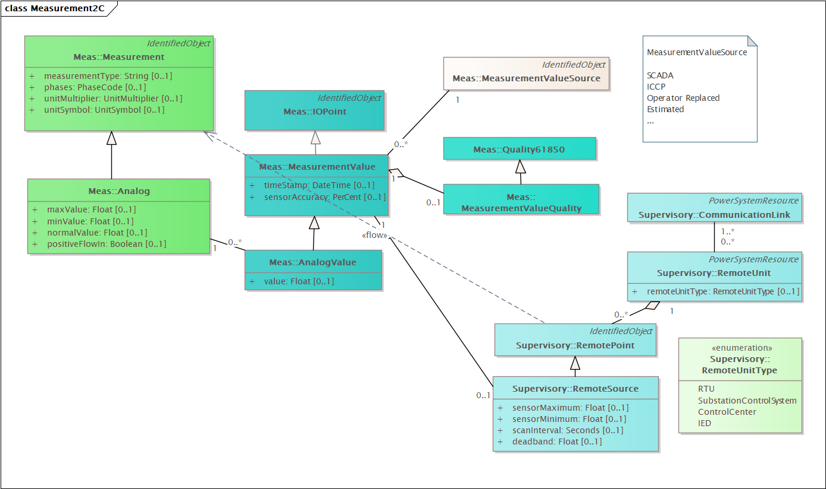
SCADA oriented model: Measurement and MeasurementValue
…
Left: Measurement = static information
Middle: the values that change
Right: where the data comes from

Slide 9
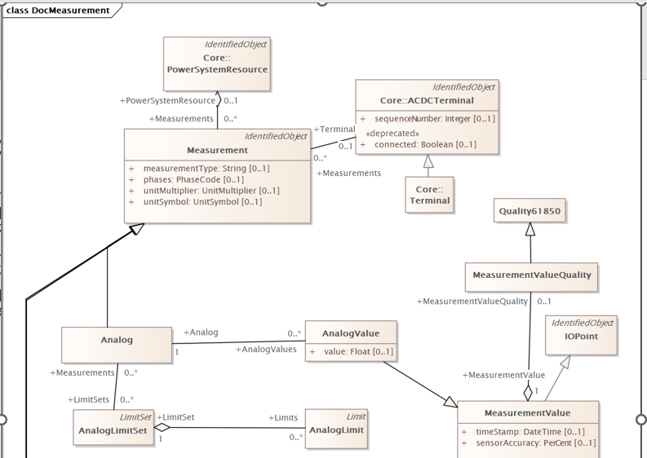
(as-is) Model
each Measurement instance represents a technological quantity of a PowerSystemResource;
each MeasurementValue of a Measurement represents a value for the technological quantity, as supplied from a single source;

Slide 10
MeasurementType
Issues:
measurementTypes – what are valid values?
Consistency checks:
phases, units, MeasurementType
Phases mainly useful in unbalance systems
But other options are possible

Slide 11
MeasurementType strings
Needs update
measurementType | 61850 Name | description
Current | Amp | Current (rms) of a non-three phase circuit
ThreePhaseCurrent | AvAmps | Total current (rms) in a three phase circuit
PhaseCurrent | A | Measured phase current.
Frequency | Hz | Frequency
PowerFactor | PwrFact | Power factor not allocated to a phase
ThreePhasePowerFactor | TotPF | Average power factor in a three phase circuit
ThreePhaseApparentPower | TotVA | Total apparent power in a three phase circuit
ThreePhaseReactivePower | TotVAr | Total reactive power in a three phase circuit
ThreePhaseActivePower | TotW | Total real power in a three phase circuit.
ApparentPower | VolAmp | Apparent power in a non-three phase circuit
ReactivePower | VolAmpr | Reactive power in a non-three phase circuit
Voltage | Vol | Voltage (rms) not allocated to a phase
ActivePower | Watt | Real power in a non-three phase circuit
Pressure | Pres | Pressure
Temperature | Tmp | Temperature
Angle | Ang | Angle between voltage and current
ApparentEnergy | TotVAh | Apparent energy
ReactiveEnergy | TotVArh | Reactive energy
ActiveEnergy | TotWh | Real energy
Automatic | Auto | Automatic operation (not manual)
LocalOperation | Loc | Local operation (not remote)
SwitchPosition | Pos | Switch position [2bits= intermediate,open,closed,ignore]
TapPosition | TapPos | Tap position of power transformer or phaseshifter
Operation Count | OperCnt | Operation count – typically for switches
LineToNeutralVoltage |  | Line to neutral voltage.
LineToGroundVoltage |  | Line to ground voltage.
Specialization |  | Used when a specialization of the Analog class defines the type of measurement rather than the Measurement.measurementType attribute.
Some of these need to be machine readable
Grid related applications use generic measurement types (= classic SCADA) qualified by the MeasurementType attribute.
Challenge: how to map to DC equipment, DER and other FunctionBlock attributes
IEC 61850 has same problem and a much longer list.
Note: Asset related measurements use specialized classes instead.

Slide 12
MeasurementType – three phase values
CIM class | measurementType | 61850 Name | description
Analog | Frequency | Hz | Frequency
Analog | ThreePhaseApparentPower | TotVA | Total apparent power in a three phase circuit
Analog | ThreePhaseReactivePower | TotVAr | Total reactive power in a three phase circuit
Analog | ThreePhaseActivePower | TotW | Total real power in a three phase circuit.
Analog | ThreePhasePowerFactor | TotPF | Average power factor in a three phase circuit
Analog | ThreePhaseCurrent | (deprecated) AvAmps | Total current (rms) in a three phase circuit
Analog | AveragePhaseCurrent | AvAPhs | Arithmetic average of the magnitude of current of the 3 phases. Average (Ia,Ib,Ic)
Analog | AverageLineVoltage | AvPPVPhs | Arithmetic average of the magnitude of phase to phase voltage of the 3 phases: average(PPVa, PPVb, PPVc).
Analog | AveragePhaseVoltage | AvPhVPhs | Arithmetic average of the magnitude of phase to reference voltage of the 3 phases: average(PhVa, PhVb, PhVc).
S = V x I

Slide 13
MeasurementType – single phase quantities
CIM class | measurementType | 61850 Name | description
Analog | ApparentPower | VolAmp | Apparent power in a non-three phase circuit Non-phase-related AC apparent power
Analog | ReactivePower | VolAmpr | Reactive power in a non-three phase circuit Non-phase-related AC reactive power
Analog | Voltage | Vol | Voltage (rms) not allocated to a phase Non-phase-related AC or DC voltage of the auxiliary network.
Analog | ActivePower | Watt | Real power in a non-three phase circuit Non-phase-related AC real power OR DC power
Analog | Current | Amp | Current (rms) of a non-three phase circuit Non-phase-related AC rms voltage OR DC voltage
Analog | PowerFactor | PwrFact | Power factor not allocated to a phase Non-phase-related AC power factor
3 x Analog | PhaseCurrent LineCurrent | A.phsA A.phsB A.phsC | Measured phase current. Phase to ground/phase to neutral three phase currents (One value per phase)
3 x Analog | LineToNeutralVoltage | PNV.phsA PNV.phsB PNV.phsC | Line to neutral voltage. Phase to neutral voltages. One value per phase
3 x Analog | LineToGroundVoltage | PhV.phsA PhV.phsB PhV.phsC | Line to ground voltage. Phase to ground voltages. One value per phase

Slide 14
Counters = Accumulator
CIM class | measurementType | 61850 Name | description
Accumulator | ApparentEnergy | TotVAh | Net apparent energy since last reset.
Accumulator | ReactiveEnergy | TotVArh | Net reactive energy since last reset.
Accumulator | ActiveEnergy | TotWh | Net real energy since last reset.
Accumulator | ActiveEnergySupply | SupWh | Real energy supply (default direction: towards grid busbar)
Accumulator | ReactiveEnergySupply | SupVArh | Reactive energy supply (default direction: towards grid busbar)
Accumulator | ActiveEnergyDemand | DmdWh | Real energy demand (direction: from grid busbar)
Accumulator | ReactiveEnergyDemand | DmdVArh | Reactive energy demand (direction: from grid busbar)

Slide 15
Setpoint + Analogs
CIM class | measurementType | 61850 Name | description
Analog OR Discrete + Setpoint | TapPosition | TapPos | Tap position of power transformer or phaseshifter (measurement and/or control)
Analog + Setpoint | VoltageSetpoint | VolSPt | Voltage setpoint for example for power transformer tap changer controller or capacitor bank control. (control and feedback measurement)
Analog + Setpoint | VoltageReferenceSetpoint | VRefSPt | Reference voltage (VRef) setpoint for voltage-reactive power operational function. (control and feedback measurement)
Analog + Setpoint | ActivePowerSetpoint | WSpt | Active power setpoint (control and feedback measurement)
Analog + Setpoint | ActivePowerLimit | WMaxSpt | Limiting setpoint of the DER's active power (control and feedback measurement)

Slide 16
Discrete
CIM class | measurementType | 61850 Name | description
Discrete | Automatic | Auto | True means automatic operation (not manual) (status and control)
Discrete | LocalOperation | Loc | True means local operation (not remote)
Discrete | ResetStatistics | RsStat | True initiates resetting of statistics
Discrete | SwitchPosition | Pos | Switch position [2bits= intermediate,open,closed,ignore] (status and/or control)
Discrete | TapChange | TapChg | Tap position adjustment in given direction (raise, lower) (control)
Discrete OR Analog | OperationCount | OperCnt OpCnt | Operation count, for example for switch or breaker operations (status)
Analog + Setpoint | OperationCountReset | OperCnt OpCntRs | Operation count resettable (status and/or control)

Slide 17
Multiple measurements for the same quantity
At the same terminal e.g. RMS & average values.
Need a way to distinguish them …
Add attributes for
CalculationMethod: RMS, Average, Min, Max
CalculationPeriod : 3 s, 15 minute, 1 day, 1 week, 1 hour
IEC 61869-9 MeterReading 18 properties

Slide 18
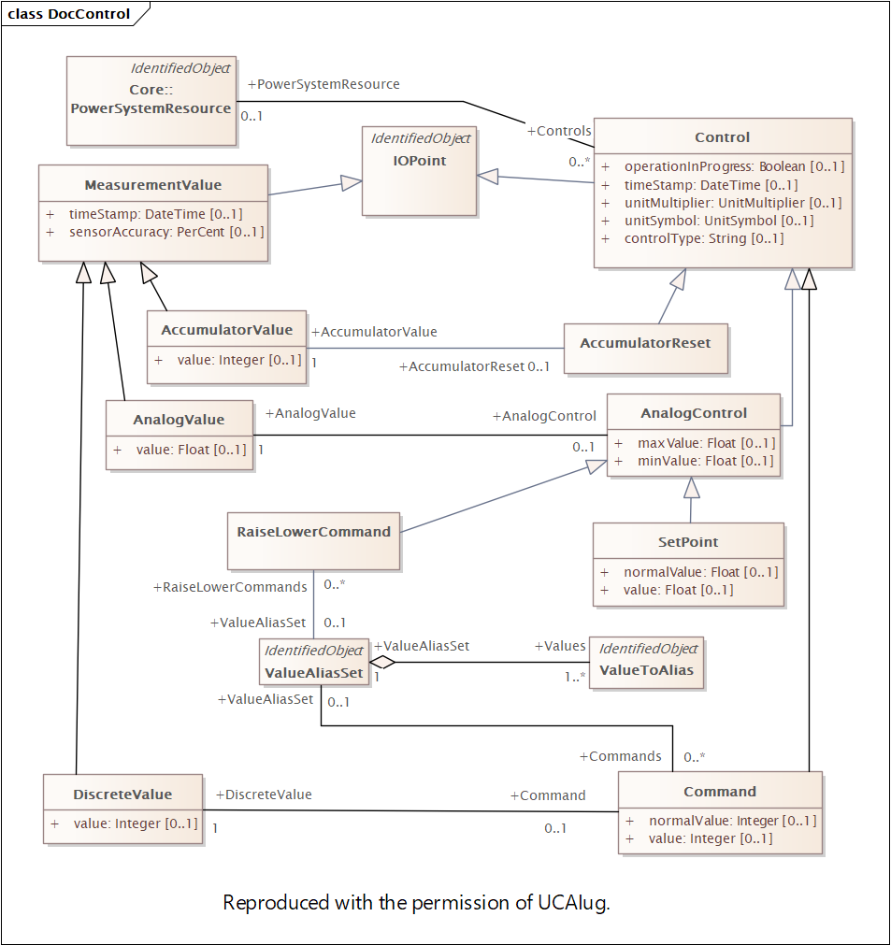
Control Type
Similar to MeasurementType
Except CIM documents don’t list any strings
And many (most?, all?) controls are associated with a measurement which has its own type.
To be revised to use same design pattern as Measurement / MeasurementValue
Control = static information
ControlValue = dynamic
…

Slide 19
Control (& Setpoint) Type
Problem statement:
How can automated systems know which control is which (relevant for coordinated control, SIPS, …)
Today controls are identified objects = ok for humans via SCADA and switching schedules
Options:
- add controlType attribute as string with CIM specific names (cf MeasurementType)
- add controlType attribute as string with IEC 61850 naming conventions (cf MeasurementType)
specialized control classes (not easy to extend)
…

Slide 20
Measurement Source
each Measurement instance represents a technological quantity of a PowerSystemResource;
each MeasurementValue of a Measurement represents a value for the technological quantity, as supplied from a single source;
the source attribute in MeasurementValueQuality then indicates whether the source actually provided the current value, or whether it had been substituted or defaulted.
Name | description
SCADA | Telemetered values received from a local SCADA system
CCLink | Value received from a remote control centre via TASE.2 or other control centre protocol
Operator | Operator entered value (always manually maintained, PSR is not connected to an RTU)
Estimated | Value updated by a state estimator
PowerFlow | Value updated as result of a Powerflow
Forecasted | Value that is planned or forecasted.
Calculated | Calculated from other measurement values (e.g. a sum)
Allocated | Calculated by a load allocator
Other options?

Slide 21
Thank you
Questions?

