Slide 1
IEC TC57/WG10 Report on units in IEC 61850
Thierry Dufaure February 26th, 2025

Slide 2
Agenda
Current usage of « units » in different IEC 61850 documents
Data Object extension rules

Slide 3
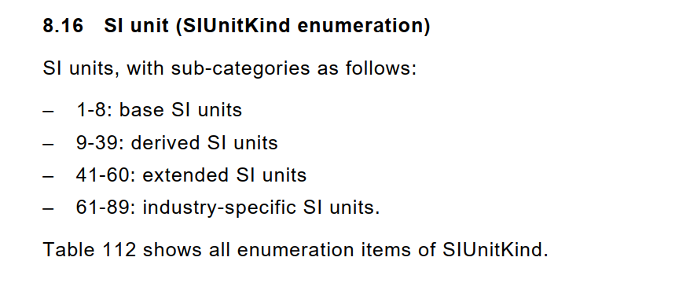
Definition of unit in IEC 61850-7-3 Enumeration
SIUnitKind – enumeration
Are extensions of SIUnitKind enumeration allowed?
Negative range by private namespace Y – restriction: not for expressing standardized unit : MV (multiplier = 6, SIUnit = V).
Positive range by TS/PAS – Y

Slide 4
Definition of unit in IEC 61850-7-3 Enumeration
MultiplierKind – enumeration (m, k, M, …)
Are extensions of MultiplierKind enumeration allowed?
Negative range already used by standard namespace
Definition of multiplier component should always be understood as 10exp(value).

Slide 5
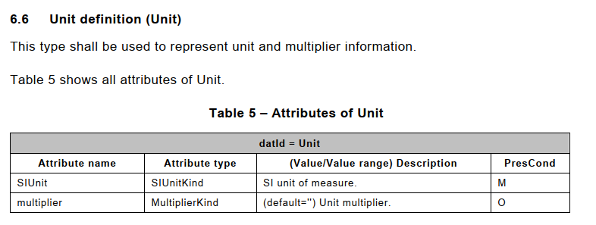
Definition of Constructed Attribute Class Unit in IEC 61850-7-3
IEC 61850-7-3 defines the Constructed Attribute Class Unit, specifying a default value for multiplier
Default multiplier: « » = 10^0

Slide 6
Instantiation of Data Attribute « units » in IEC 61850-7-3
Data Attribute « units » of type « Unit » is defined in the following CDCs:
INS, INC, ING (introduced in IEC 61850 Edition 2)
BCR
HST
MV, CMV, SAV
APC, BAC, ASG
Note: CDC: CSG, CSD are using several DataAttribute xUnits, yUnits, zUnits
Note: The component Vector.ang is specified with a fixed non exposed units: {multiplier « », deg} within a fixed range = [-180, 180]

Slide 7
Usage of unit in IEC 61850-7-4
There are Data Object names mandating their unit:
Abbreviation
Note: In IEC 61850-7-3 Edition 1 there was no Data Attribute « units » for INS, INC, ING: it made sense to mandate the unit in the Data Object name.

Slide 8
Usage of Units in IEC 61850-7-4
There are Data Object explanations indicating their unit:

Slide 9
Usage of Units in IEC 61850-7-4
There are Data Object explanation indicating their typical units:
SIUnit « K » kelvin: Temperature
Derived SIUnit « °C » degrees Celsius: Relative Temperature
Typically is used for typical usage.
There are Data Object without any units indication (for instance DO Pres [MV] vs Tmp[MV])

Slide 10
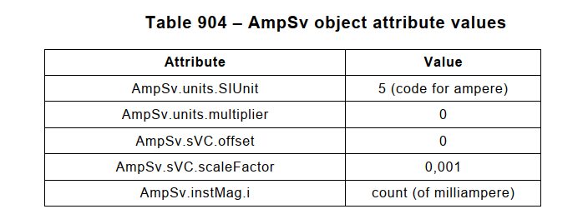
Usage of Units in IEC 61869-9
Product standard may force the unit of a Data Object as well as other configuration aspects

Slide 11
Usage of Units in IEC 61850-7-420
There are Data Object explanations indicating the different possible interpretations of a Data Object i.e. allowing different units (absolute or percentage)

Slide 12
Usage of Units in IEC 61850-7-420
There are exclusive Data Objects to select the adequate representation art (absolute or percentage)

Slide 13
IEC 61850-1-2 Data Object naming rules involving unit
General naming rule:
Mandate the unit in the the Data Object name if not SI

Slide 14
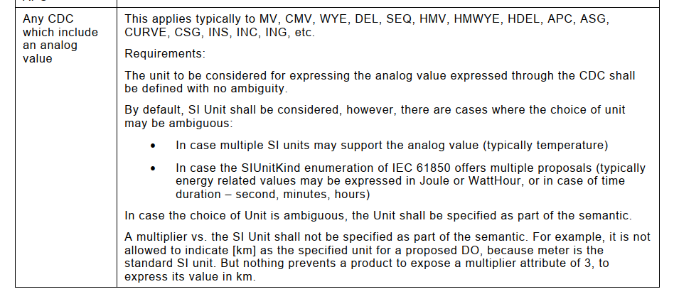
IEC 61850-1-2 Data Object extension rules involving unit
Note: there are always exception to a rule: RFLO.FltDiskm [MV] exits since IEC 61850-7-4 Edition 1

Slide 15
Recommendation
Optional Data Attributes should be used on a best effort basis and not as “as long it is not mandatory, I do not implement it”
Always prefer the self-descriptive model approach to avoid ambiguity

Slide 16
Next steps
Shall we include a unit property in the UML model, and expose it in the NSD?
Note it may be tricky when the « units » is context sensitive:
Shall we make the Data Attribute « units » mandatory in IEC 61850-7-3 Edition 3?
Notes:
How to get access to the papers?
-> E-mail sent on 16th of August to Christoph Brunner for CIGRE WG and IEEE to get access. IEEE papers should be listed.
-> Arun will check for PSRC
Thierry Coste have some additional papers to share.

Slide 17
WG10 Conclusion – Delft Meeting
Continue discussion within TF UML and Autogeneration.
Consider exposing the fixed, typical, and optional units in the UML model and in the NSD for a machine processable exposure.
Notes:
How to get access to the papers?
-> E-mail sent on 16th of August to Christoph Brunner for CIGRE WG and IEEE to get access. IEEE papers should be listed.
-> Arun will check for PSRC
Thierry Coste have some additional papers to share.

Slide 18
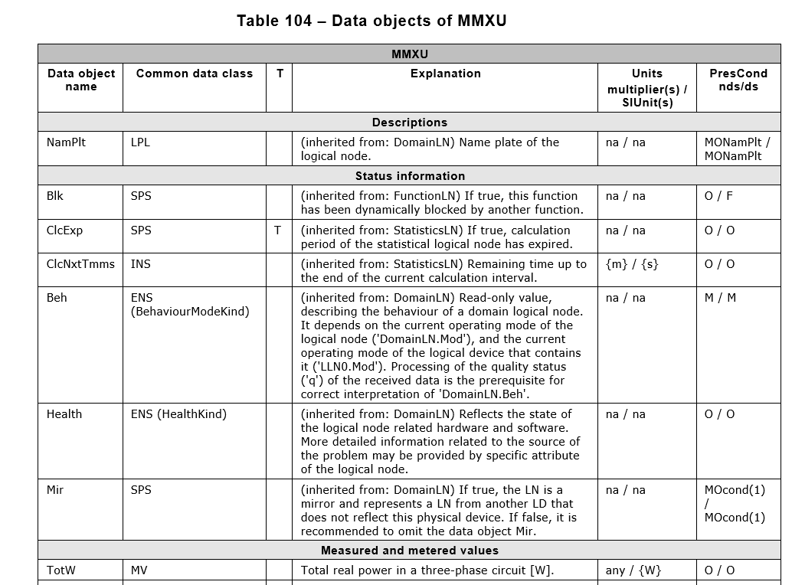
Unit properties in Word Document
How should unit property be exported in the Word Document?
Proposal
DO without unit
DO with fixed unit
DO with fixed SIUnit

Slide 19
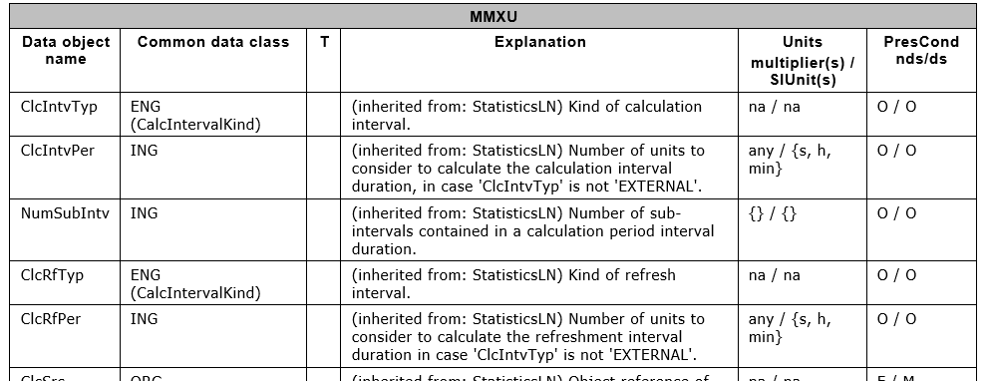
Unit properties in Word Document
How should unit property be exported in the Word Document?
Proposal
DO with multiple SIUnit
DO with fixed non unit

Slide 20
Unit properties in NSD
How should unit property be exported in the nsd?
Proposal

Slide 21
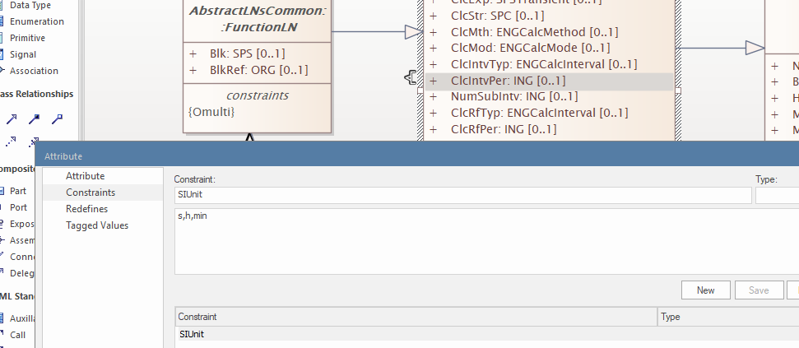
Unit Property in UML
How to specify the unit property in UML?
Proposal as constraints of the DO instance

Slide 22
AHTF Conclusion – Fribourg meeting
Exposing the fixed, typical, and optional units in the UML model, in the NSD and in Word document for a machine processable exposure. But first after Edition 2025.
In 1-2 revision – Description text shall expose the units restriction; the DOName shall be unit agnostic
Approval process for SIUnitKind similar to the abbreviation approval process. SIUnitKind extension approval done inside the TF UML and Autogeneration
Notes:
How to get access to the papers?
-> E-mail sent on 16th of August to Christoph Brunner for CIGRE WG and IEEE to get access. IEEE papers should be listed.
-> Arun will check for PSRC
Thierry Coste have some additional papers to share.

Slide 23
AHTF Conclusion – Fribourg meeting
Negative extension of SIUnitKind restricted to none existing units
Extension of MultplierKind restricted to the 10exp(ord) definition.
IEC 61850-8-1 fixed length GOOSE encoding for enumeration will need to define an escape value for enumeration values bigger than the 8-bit allowed range. Tissue expected to solve the issue.
Notes:
How to get access to the papers?
-> E-mail sent on 16th of August to Christoph Brunner for CIGRE WG and IEEE to get access. IEEE papers should be listed.
-> Arun will check for PSRC
Thierry Coste have some additional papers to share.

Slide 24
www.iec.ch

