Slide 1

CIM models for capabilities of Grid Edge Devices and EV as DERs
Discussion with reference to IEEE 1547, IEC 61850-7-420, IEC 61968-5
Tom Berry
Event: CIM UML Features 13 March 2025
Location: Remote

Slide 2
DER capabilities and controls: principles
Assets, AssetInfo – used to initialize Grid, Market resource models
  Implies similar, maybe identical classes associated to Asset or PowerSystemResource
Market:RegisteredDistributedResource is equivalent to
Grid :{PowerElectronicsConnection + n*PowerElectronicsUnit}
Grid resource modelling can re-use RegisteredResource aggregation
IEC 62746-4 models partially supersede DERGroup from IEC 61968-5
Resource associations with Measurements and Meters are a way to record mappings to the real-time communication systems & protocols
Other mappings like IEC 61850 and IEEE 2030.5 may need new classes

Slide 3
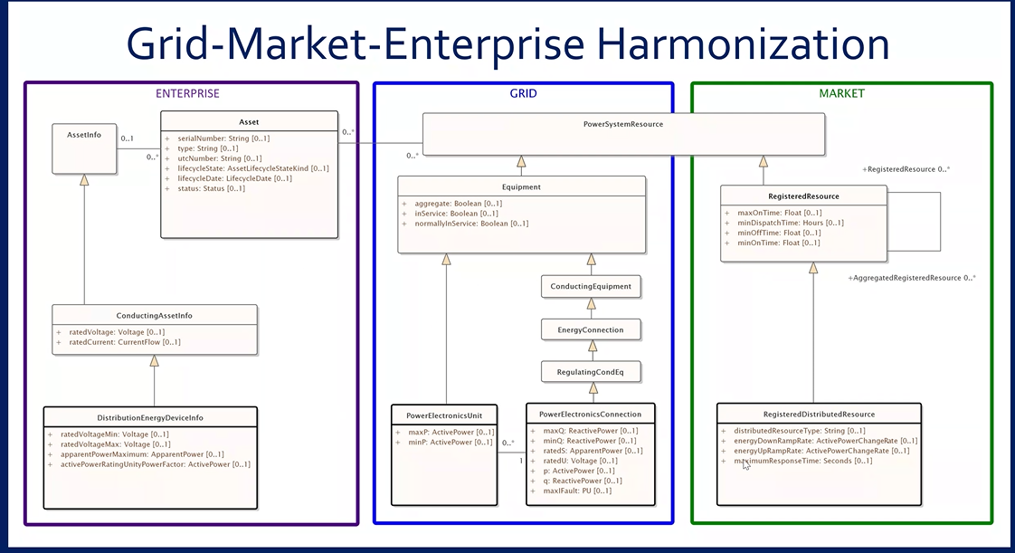
Reminder – these are different resources

Slide 4
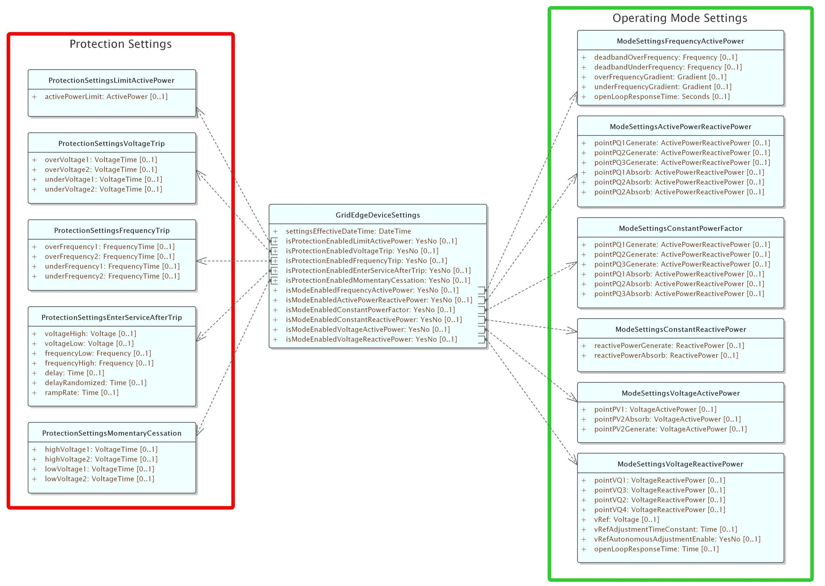
Control parameters
working proposal based on IEEE 1547
To be mapped to IEC 61850
Power limits should be upper and lower limits
To add settings to show
gridFormingCapability / Mode
How to handle regional specific rules for grid forming ?
Maybe different settings for blackStartCapability / Mode
Similar, maybe identical, classes can be used for assets and for resources

Slide 5
Regardless of assets …
Grid and Market views could / should share same model of control capabilities

Slide 6
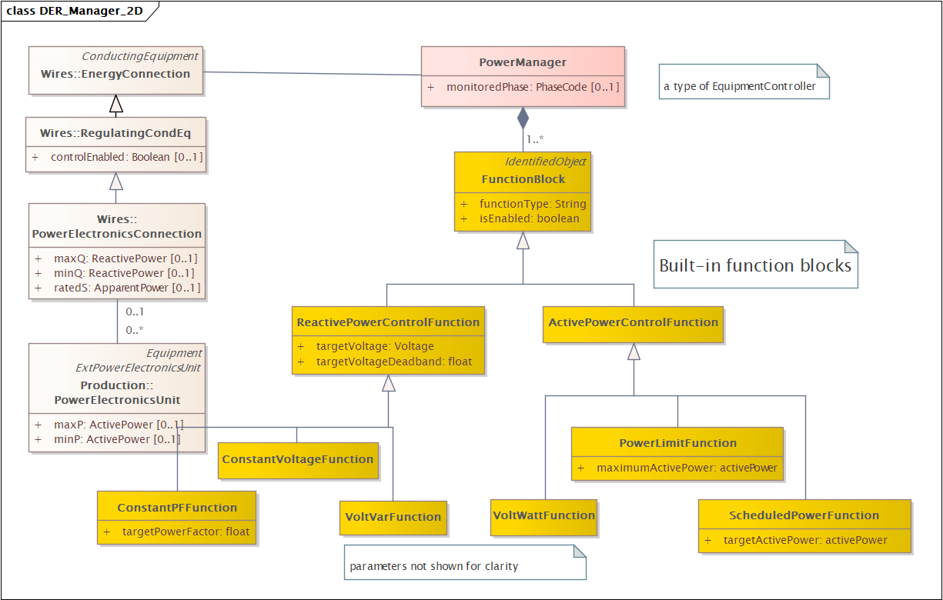
Grid: Capabilities & Control Functions
Updated 13/02
Wires class have nameplate parameters
Function Blocks provide a richer set of functions than Regulating Control
Function blocks can also be defined to apply operational limits to P,Q

Slide 7
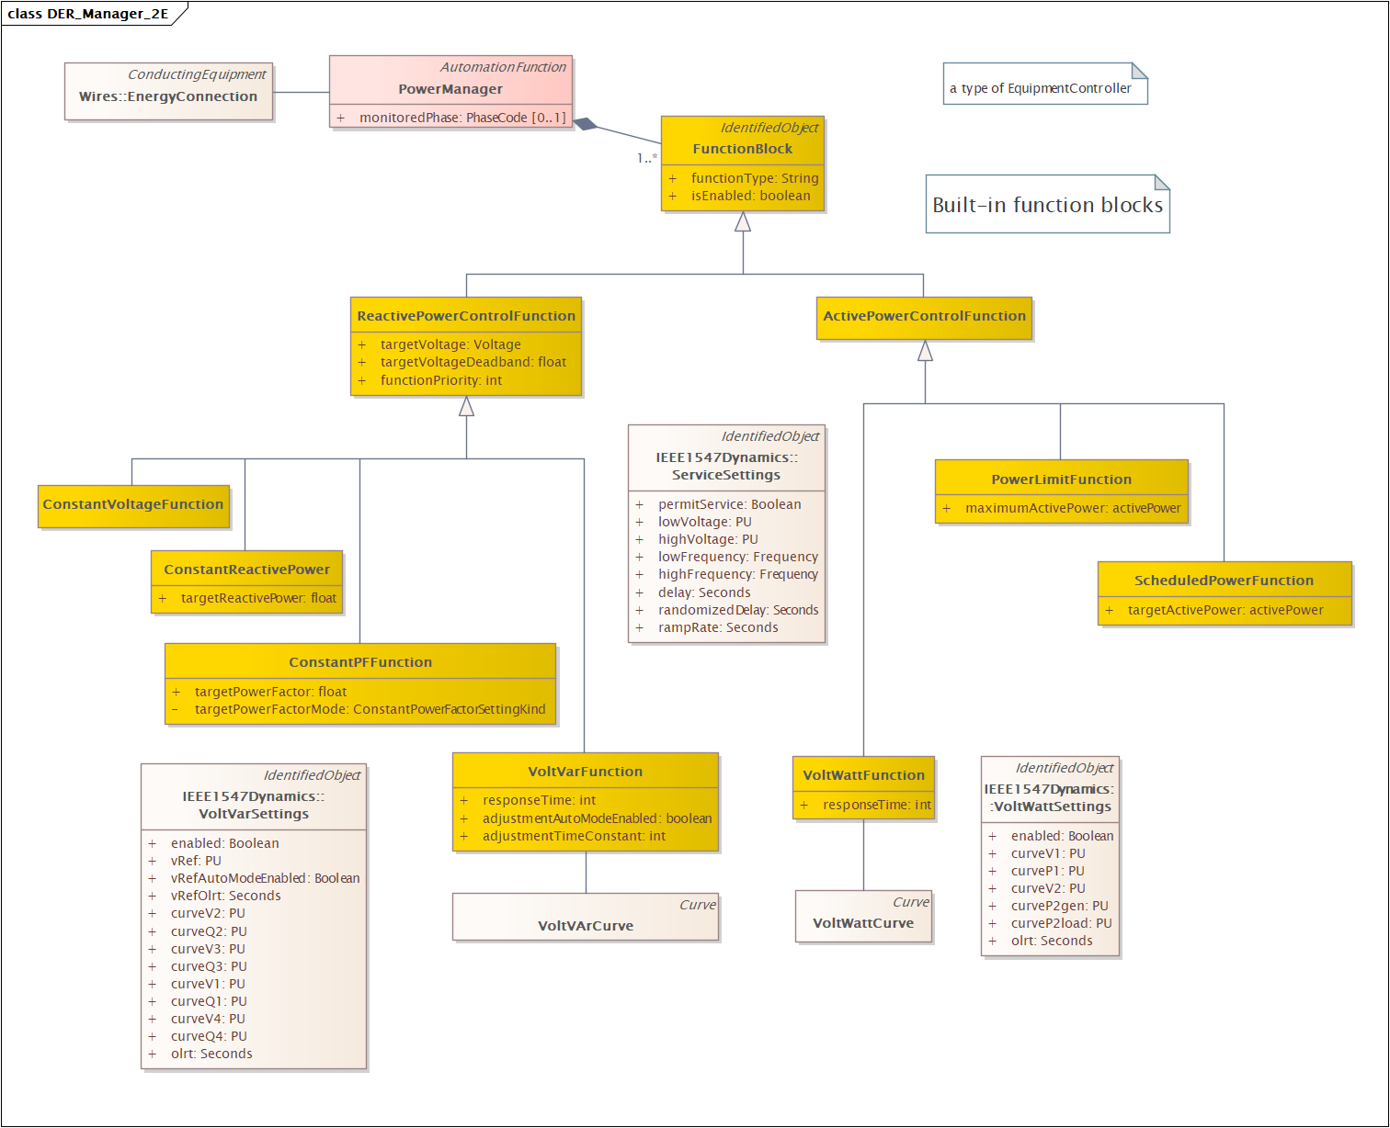
Function Settings
New 13/03
Similar to IEEE 1547 Dynamics
with more friendly names
Choice: fixed attributes vs curves
Not including scheduling
e.g.:
targetVoltage, maximumActivePower
…
Issue: functionPriority
0 = low or 0 = high?

Slide 8
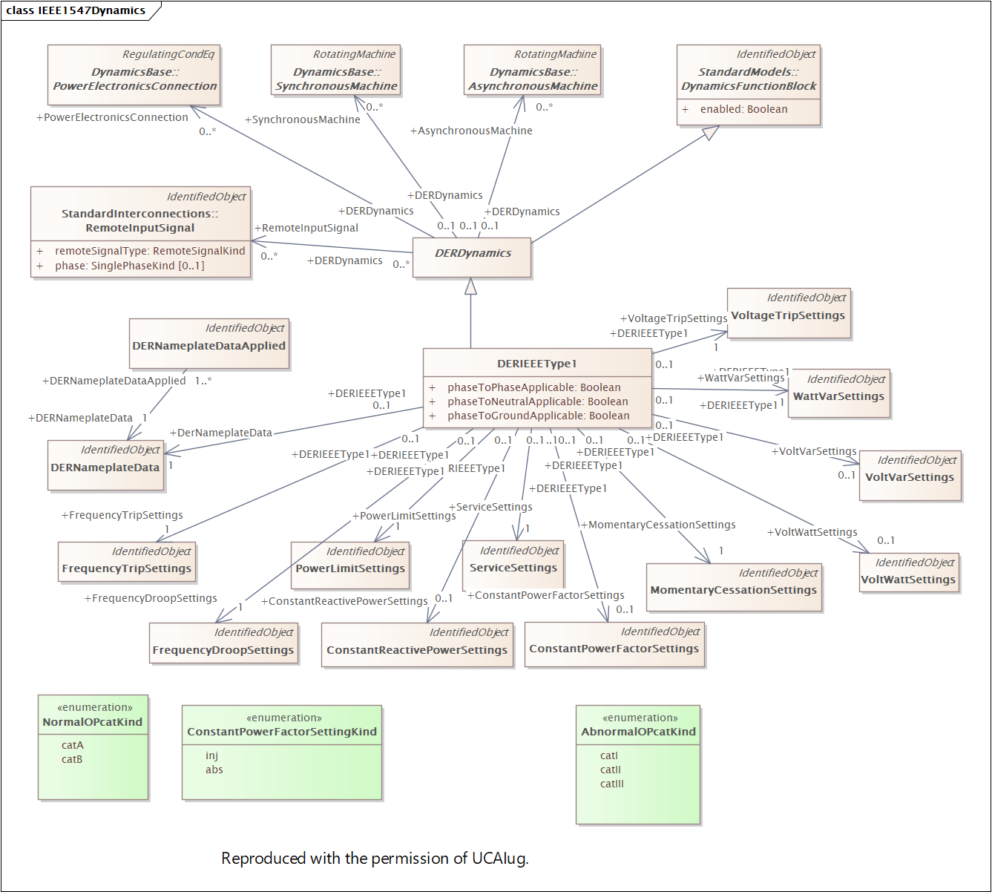
IEEE 1574 Dynamics
Reference
Various settings classes

Slide 9
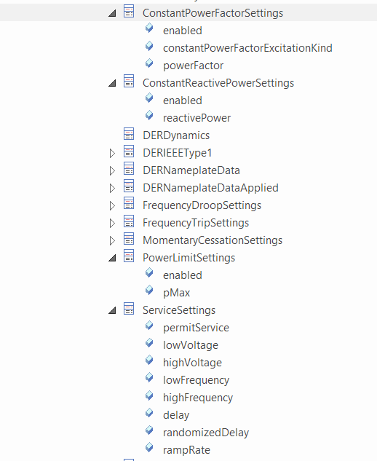
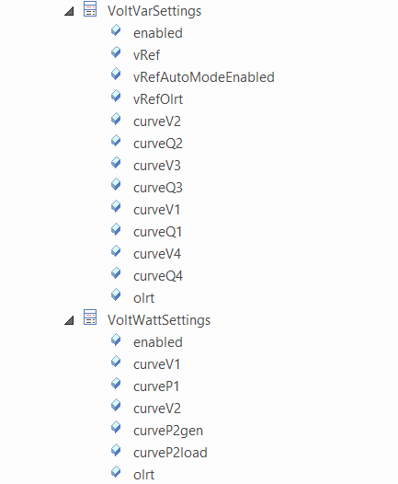
IEEE 1574 Dynamics
Reference
Settings based on IEEE 1547 descriptions
Note fixed names
(not generic curves)

Slide 10
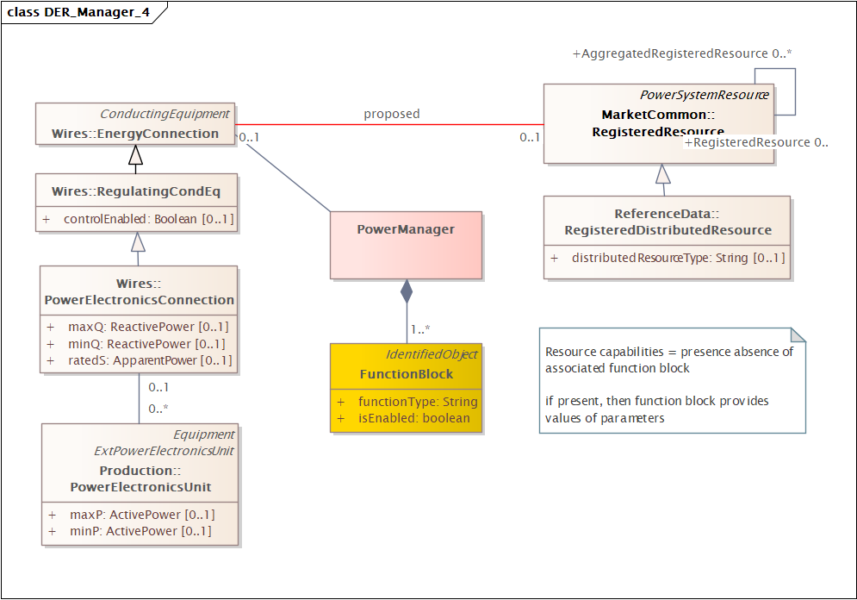
Grid – Market: explicit association for resources
Updated 13/02
Grid resource could correspond to either
- aggregated resource
- physical resource
Update
resources may be controllable loads
=> association with Energy Connection

Slide 11
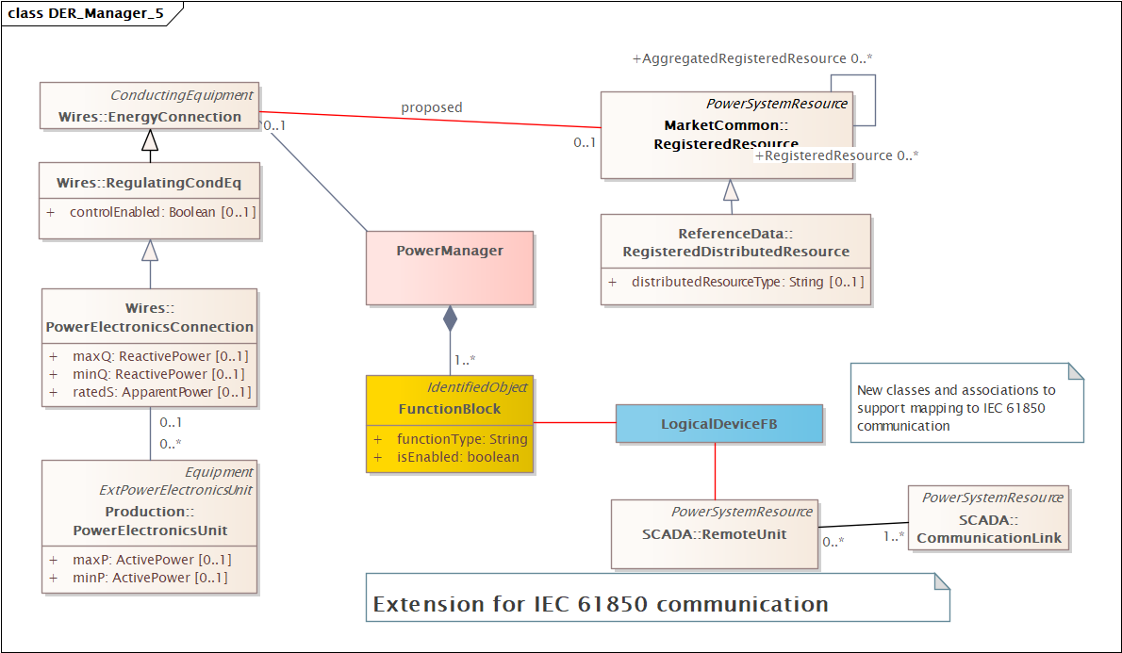
Real-time communication #1
IEC 61850 mapping
Updated 13/02
New classes and associations to support mapping to IEC 61850 communication (mainly identification).

Slide 12
Real-time communication #1
SCADA Package name / description
Updated 13/02
SCADA is the package name, not a system, which is confusing.
Redmine 7124
Maybe change package name
Maybe change description to:
Contains entities to model information used for operational supervision, control, and data acquisition in power system applications function.
Supervision involves real-time monitoring and decision support, enabling operator and automated control of equipment such as opening or closing a breaker. Data acquisition gathers real-time measurements from various sources, independent of the underlying communication technology.

Slide 13
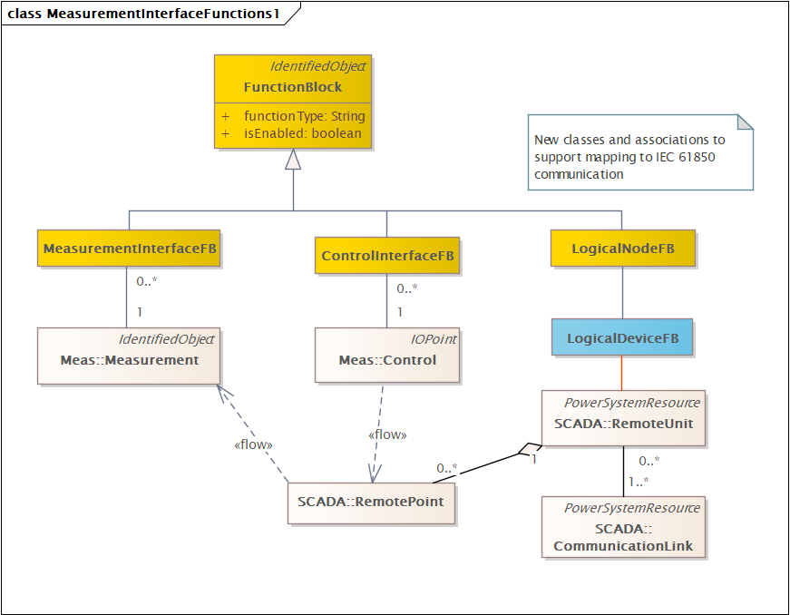
Real-time communication #2
Generic interface
skip
Power management functions are “pure” calculation for supporting analyses
Add more function blocks for links to the outside world
Note: this means models also need function-function links

Slide 14
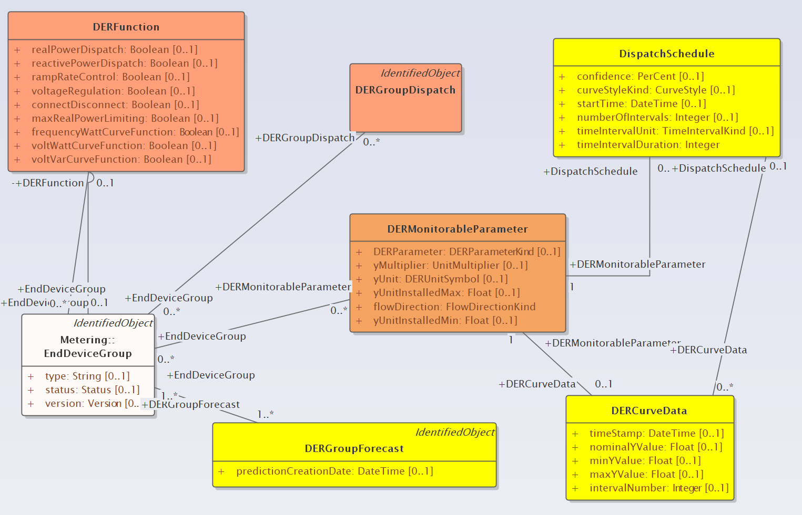
IEC 62746-4 models partially supersede DERGroup from IEC 61968-5
Classes in yellow have an equivalent in IEC 62746-4
Classes in orange have no existing direct mapping
DERFunctions – capabilities
DERMonitorableParameter – a way of exchanging measurements and setpoints.
DERGroupDispatch = ???
EndDeviceGroup = a specific type of aggregation

Slide 15
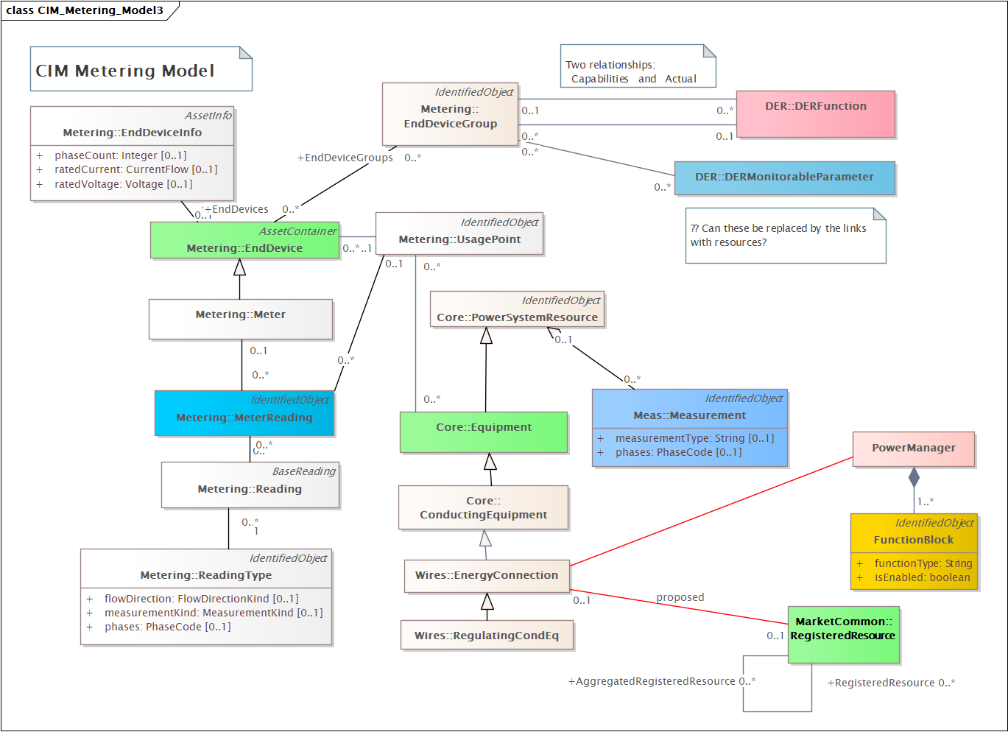
Measurement, MeterReading,
MonitorableParameter
= alternative ways of collecting data
Needs more thought and discussion …

Slide 16
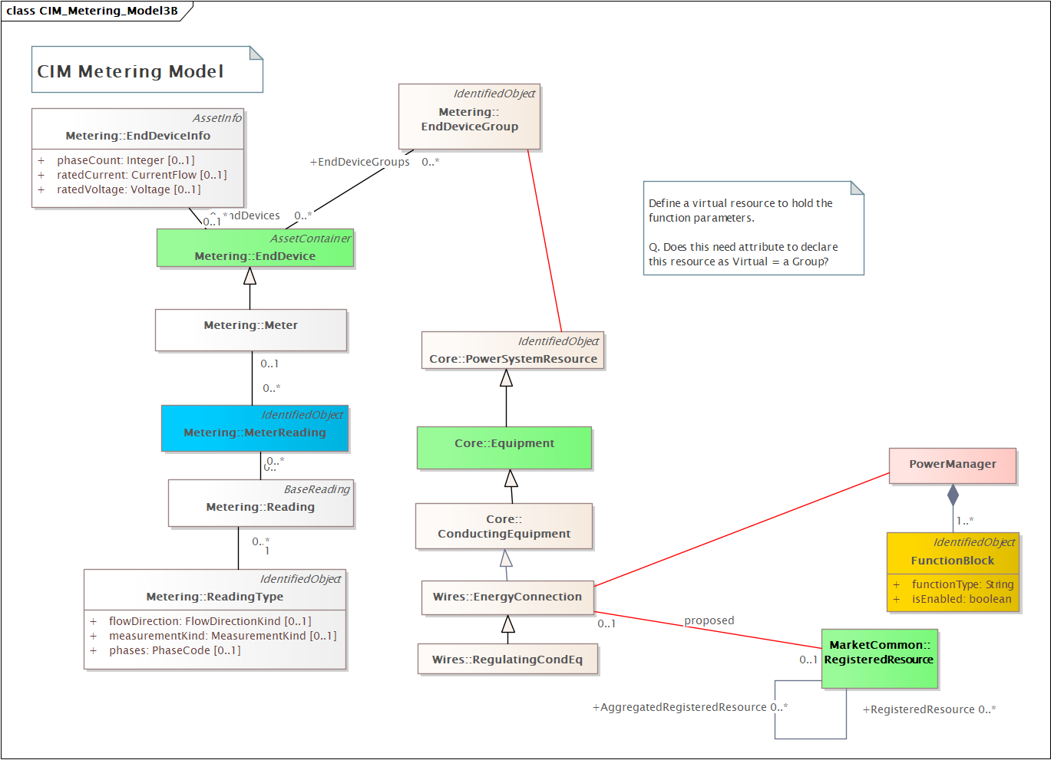
DERFunction and
MonitorableParameter
Updated 13/02
Proposal:
Link EndDeviceGroup to virtual resource that has the function parameters.
And may or may not be associated with a registered resource

Slide 17
DERFunction and
MonitorableParameter
Updated 13/02
BUT
Two ways of defining groups

Slide 18
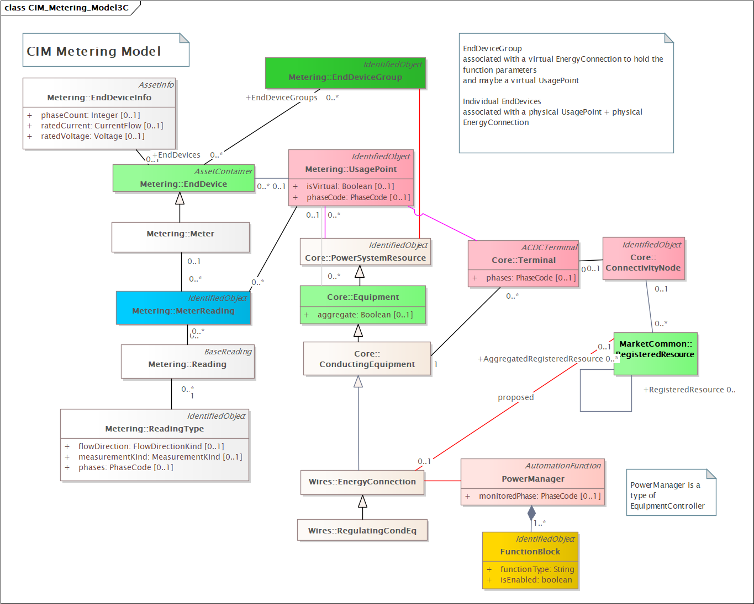
Linkage by UsagePoint
New 07/03
…

Slide 19
In progress
Support for IEEE 2030.5
Support for changing DER parameters by schedules
…

