Slide 1
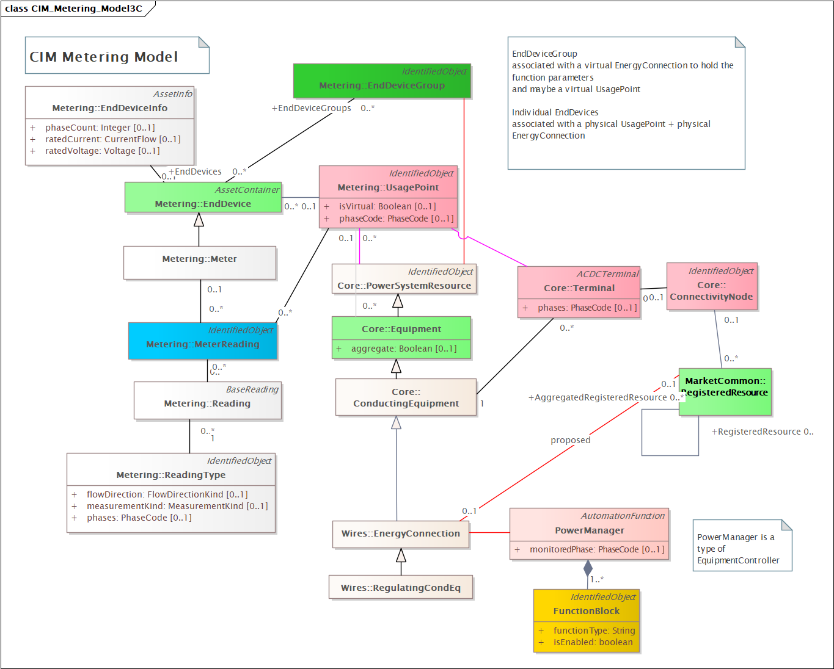
Linkage by UsagePoint
…

Slide 2
To do
Support for IEEE 2030.5
Support for changing DER parameters by schedules
…

