Slide 1
CIM models for capabilities of Grid Edge Devices and EV as DERs Discussion with reference to IEEE 1547, IEC 61850-7-420, IEC 61968-5
Tom Berry
Event: UCA TF13
Date: 29 January 2024
Location: Remote

Slide 2
DER capabilities and controls: principles
Assets, AssetInfo – used to initialize Grid, Market resource models
Implies similar, maybe identical classes associated to Asset or PowerSystemResource
Market:RegisteredDistributedResource is equivalent to
Grid :{PowerElectronicsConnection + n*PowerElectronicsUnit}
Grid resource modelling can re-use RegisteredResource aggregation
IEC 62746-4 models partially supersede DERGroup from IEC 61968-5
Resource associations with Measurements and Meters are a way to record mappings to the real-time communication systems & protocols
Other mappings like IEC 61850 and IEEE 2030.5 may need new classes

Slide 3
Reminder – these are different resources

Slide 4
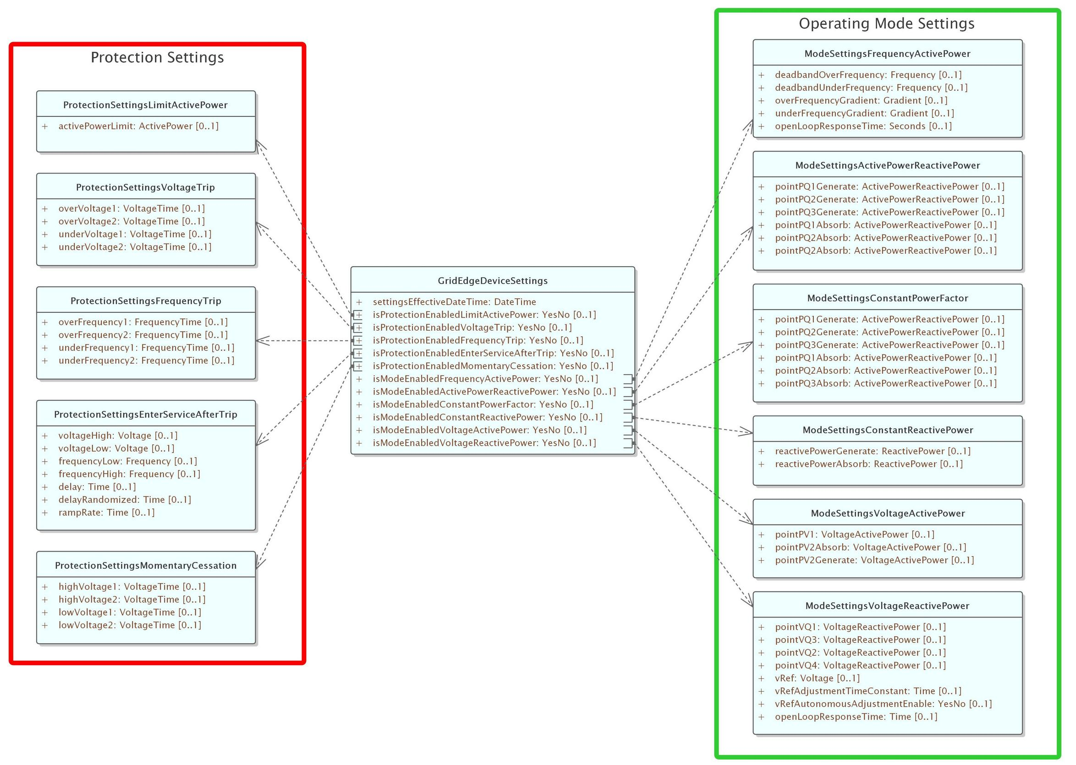
Control parameters
working proposal based on IEEE 1547
To be mapped to IEC 61850
Power limits should be upper and lower limits
To add settings to show
gridFormingCapability / Mode
How to handle regional specific rules for grid forming ?
Maybe different settings for blackStartCapability / Mode
Similar, maybe identical, classes can be used for assets and for resources

Slide 5
Regardless of assets …
Grid and Market views could / should share same model of control capabilities

Slide 6
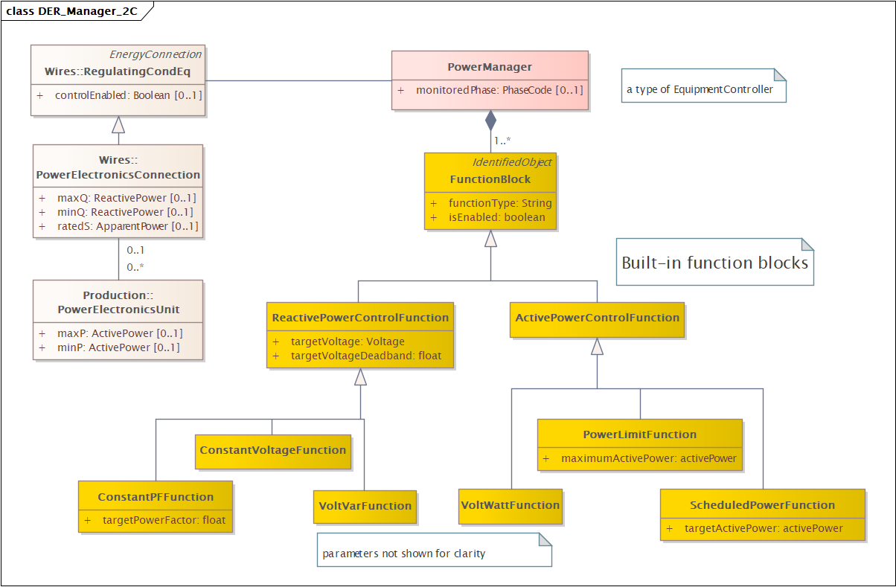
Grid: Capabilities & Control Functions
Wires class have nameplate parameters
Function Blocks provide a richer set of functions than Regulating Control
Function blocks can be defined to apply operational limits to P,Q

Slide 7
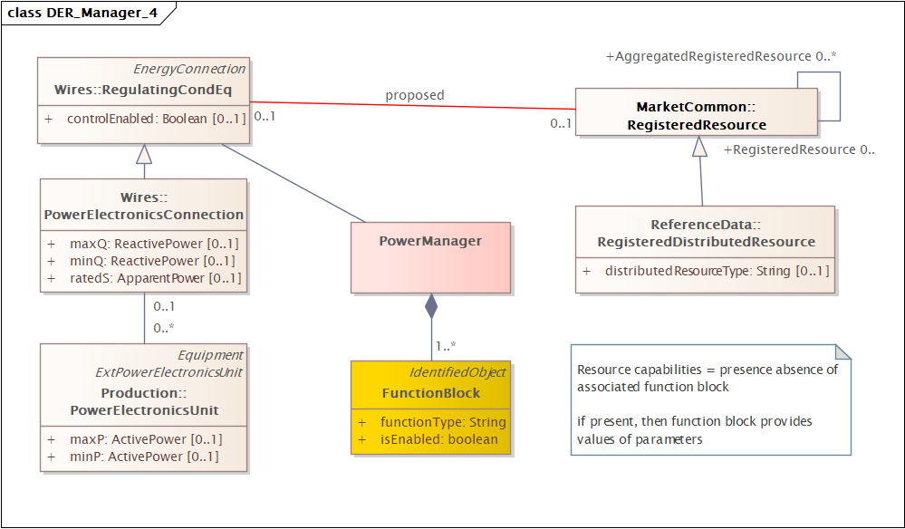
Grid – Market: explicit association for resources
Energy Connection
Grid resource could correspond to either
- aggregated resource
- physical resource
Discussion
Does this include resources that are controllable loads
=> better to associate with Energy Connection

Slide 8
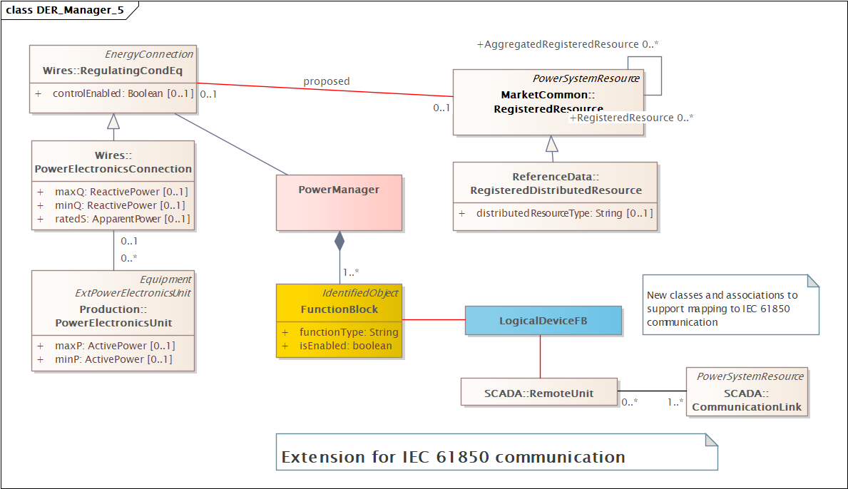
Real-time communication #1 IEC 61850 mapping
New classes and associations to support mapping to IEC 61850 communication
(mainly identification)

Slide 9
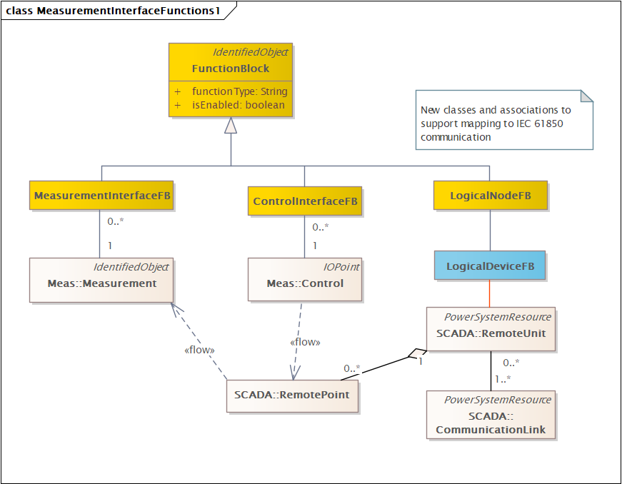
Real-time communication #2 Generic interface
Power management functions are “pure” calculation for supporting analyses
Add more function blocks for links to the outside world
Note: this means models also need function-function links

Slide 10
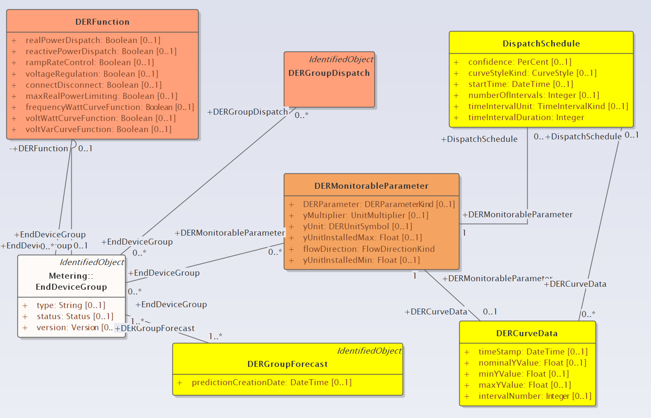
IEC 62746-4 models partially supersede DERGroup from IEC 61968-5
Classes in yellow have an equivalent in IEC 62746-4
Classes in orange have no existing direct mapping
DERFunctions – capabilities
DERMonitorableParameter – a way of exchanging measurements and setpoints.
DERGroupDispatch = ???
EndDeviceGroup = a specific type of aggregation

Slide 11
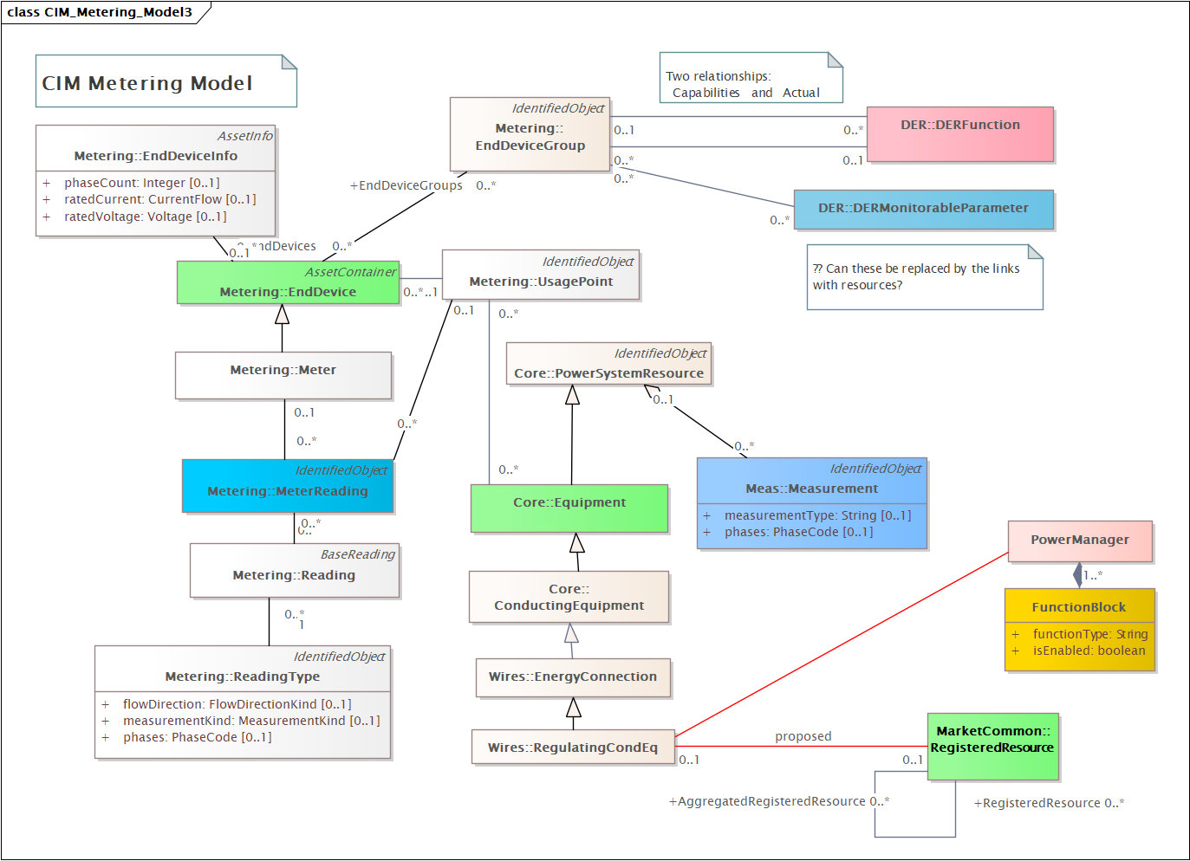
Measurement, MeterReading, MonitorableParameter
= alternative ways of collecting data
Needs more thought and discussion …

Slide 12
To do
Support for IEEE 2030.5
Support for changing DER parameters by schedules
…

