Slide 1
IEC 63382 Management of Distributed Energy Storage Systems based on Electrically Chargeable Vehicles Proposals for CIM extensions for electric vehicle charging
Author: Tom Berry
Representing: TC69 JWG15
Date: 11-June-2024

Slide 2
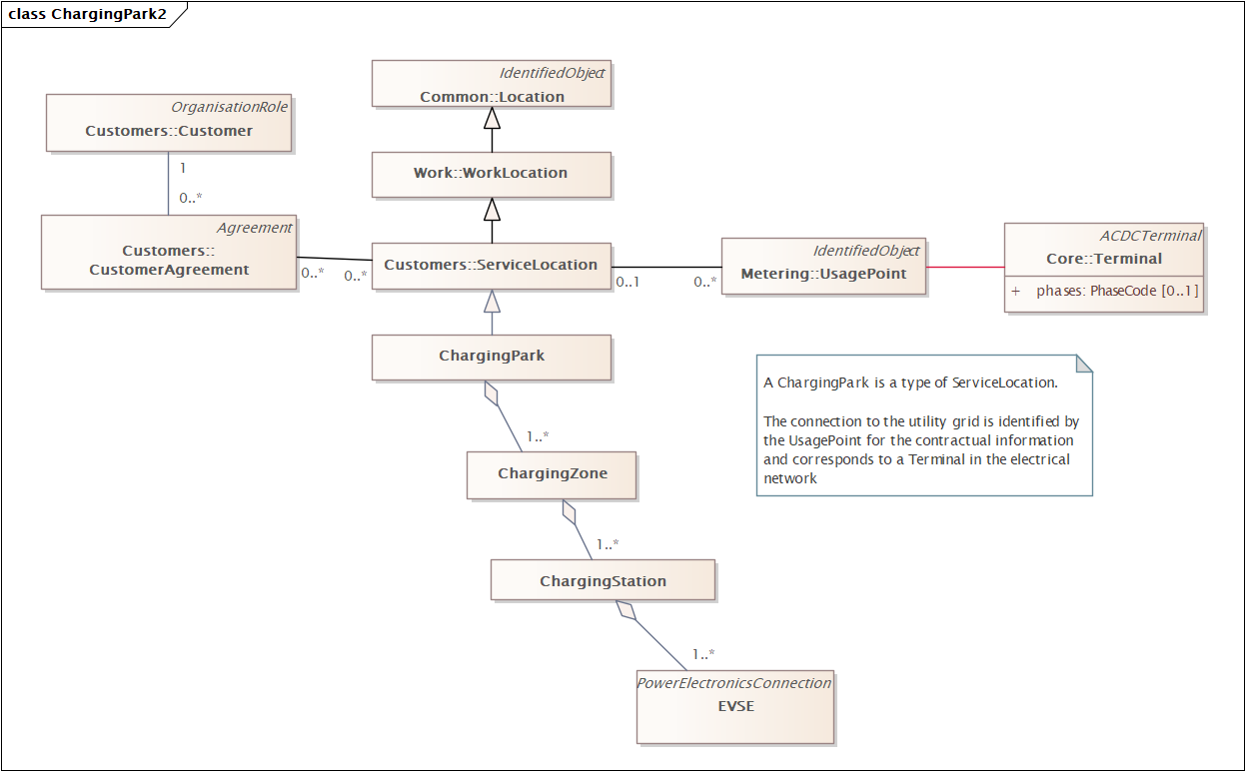
Charging Park and Contracts
A ChargingPark is a specialization of ServiceLocation
A small Park will have only one Zone

Slide 3
Charging Park and Contracts
Location is overloaded – TF14 working on changes
CustomerAgreement must be updated to support that the contact can have multiple side. Some changes will be done as part of organisation update. – TF14 working on changes
A ChargingPark is a specialization of ServiceLocation
A small Park will have only one Zone
We are looking at updating EnergyArea (SubScheduleArea) to become an efficient way to handle the control and energy forecast. – TF13 working on changes

Slide 4
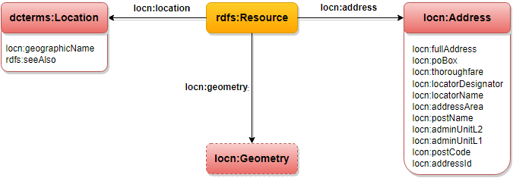
CIM Issues #5880: Location should follow Spatial Data best practice - WG14 Part 11 Issues - UCAIug Issue Tracking System
Spatial Data on the Web Best Practices (w3.org)

Slide 5
Definitions
Agreed last time
Charging Station
physical equipment consisting of one or more EV supply equipment managing the energy transfer to and from EVs. [IEC 63382-1]
Charging Park
geographical area that encloses one or more charging stations with one operator
[From : IEC 63110-1 and ISO]
Charging Zone
Power management concept representing a group of one or more charging stations within a particular charging park (typically with a relationship with the electrical arrangement)

Slide 6
Definitions
Agreed last time
Electric Vehicle Supply Equipment
EVSE
equipment or a combination of equipment, providing dedicated functions to supply electric energy from a fixed electrical installation or supply network to an EV for the purpose of charging and discharging
[SOURCE: IEC 61851-1:2017, 3.1.1, modified – The words "and discharging" have been added to the definition, and the examples have been removed.]
[IEC 63110-1] = to be used by IEC 63382
Where is the definition of EV?

Slide 7
Key Common EV Elements
Electric Propulsion: All EV definitions focus on propulsion powered by electric motors.
Energy Storage: EVs typically have on-board energy storage systems like rechargeable batteries, or in some cases, fuel cells.
External Charging: Many definitions emphasize the vehicle’s ability to recharge from an external electricity source.
Types of EVs: EVs include battery electric vehicles (BEVs), plug-in hybrid electric vehicles (PHEVs), and sometimes fuel-cell electric vehicles (FCEVs).

Slide 8
ISO 8713:2019 (Electrically Propelled Road Vehicles)
IEC 61851-1 (Electric Vehicle Conductive Charging System)
SAE J2954 (Wireless Power Transfer for Electric Vehicles)
European Union (Directive 2014/94/EU)
Definition: An electric vehicle is a motor vehicle equipped with a powertrain containing at least one non-peripheral electric machine as an energy converter with an electric rechargeable energy storage system.
A powertrain refers to the collection of components that generate power and deliver it to the wheels of a vehicle, enabling it to move. It typically includes the engine (or motor), the transmission, the drivetrain, and other associated components that work together to convert energy (such as fuel or electricity) into motion.

Slide 9
UN Regulation No. 100 (Uniform Provisions Concerning the Approval of Vehicles with Regard to Specific Requirements for the Electric Powertrain)
IEEE 2030.1.1-2015 (Guide for the Design of Electric Vehicle (EV) Supply Equipment)
Definition: An electric vehicle is defined as a vehicle using an electric motor for propulsion that is powered by energy stored in batteries or supplied through charging from external sources.
U.S. Code (49 U.S. Code § 32901):
IEC 62196 (Plugs, Socket-Outlets, Vehicle Connectors, and Vehicle Inlets for Conductive Charging of Electric Vehicles)
SAE J1772 (Electrical Connector Standards for EVs)

Slide 10
CIM Issues #6807: Add classes for EV, Electric Vehicle Supply Equipment, Charging Station, Charging Park, Charging Zone - WG13 Issues - UCAIug Issue Tracking System
Must support ferry, airplane etc
Electric Vehicle EV electrically powered road vehicle in which the energy is supplied from a battery carried on the vehicle.

Slide 11
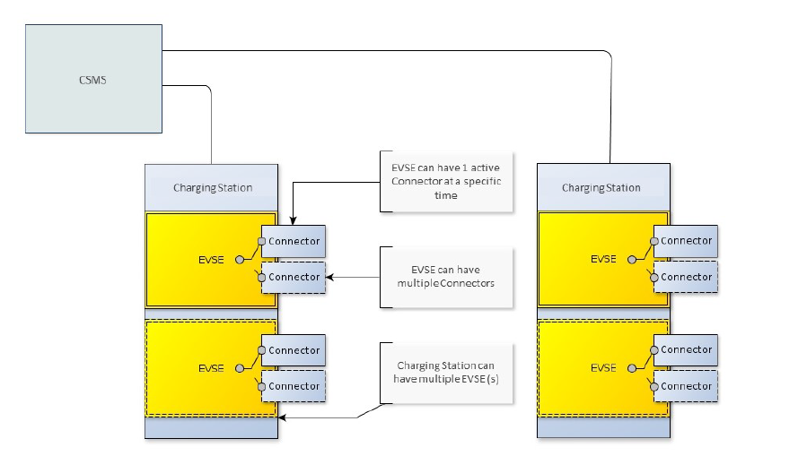
Background: definitions from OCPP
OCPP-2.0.1_part1_architecture_topology.pdf
Charging Station is the physical system where EVs can be charged.
A Charging Station can have one or more EVSEs (Electric Vehicle Supply Equipment).
An EVSE is considered as a part of the Charging Station that can deliver energy to one EV at a time

Slide 12
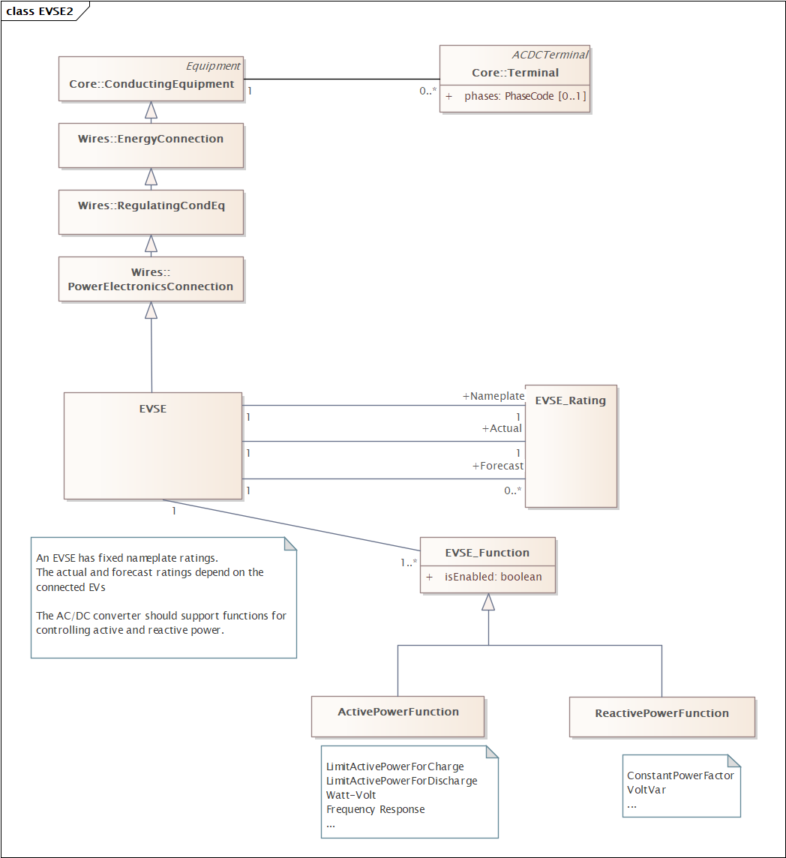
EVSE as DER
Do we need this to be a specialisation?
An EVSE is a special type of PowerElectronicsConnection
It will have ratings that depend on the connected EV
The control functions may have settings
Fixed by grid codes
Communicated from the DSO via the CSMS
Should this not be AssetInfo?
We should use the operational schedule
This should be our new control?
To do : add EVSE type information

Slide 13
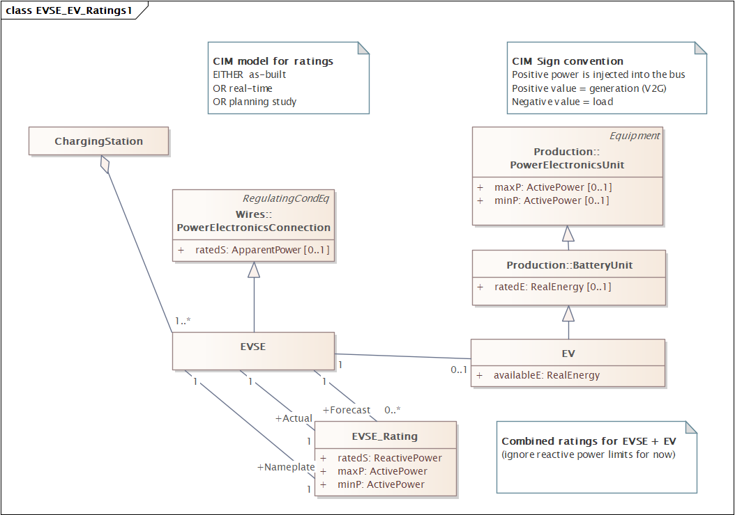
Ratings for EVSE + EV
Notes:
Modelling concepts that extend the utility control center Common Information Model (CIM)
As used for utility planning and markets.
Many of properties have equivalents in IEC 61850 models.
Mapping them to IEC 61850 models will be done later.

Slide 14
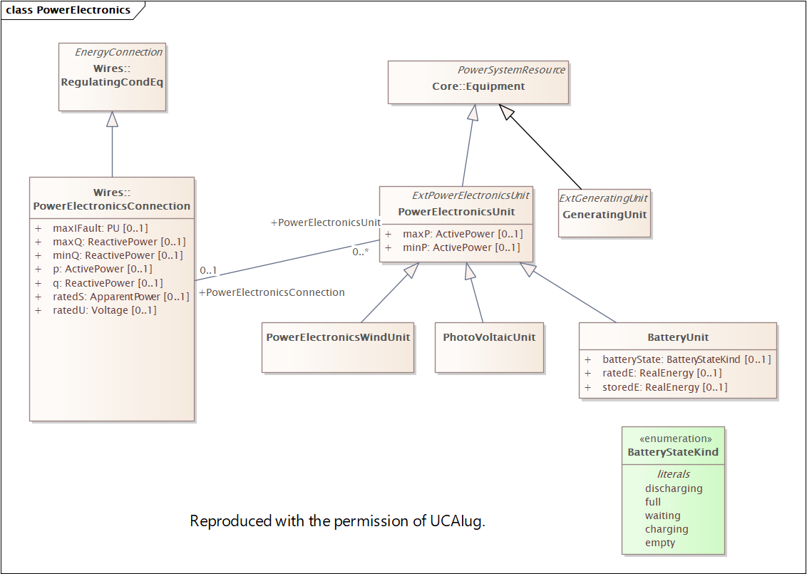

Slide 15
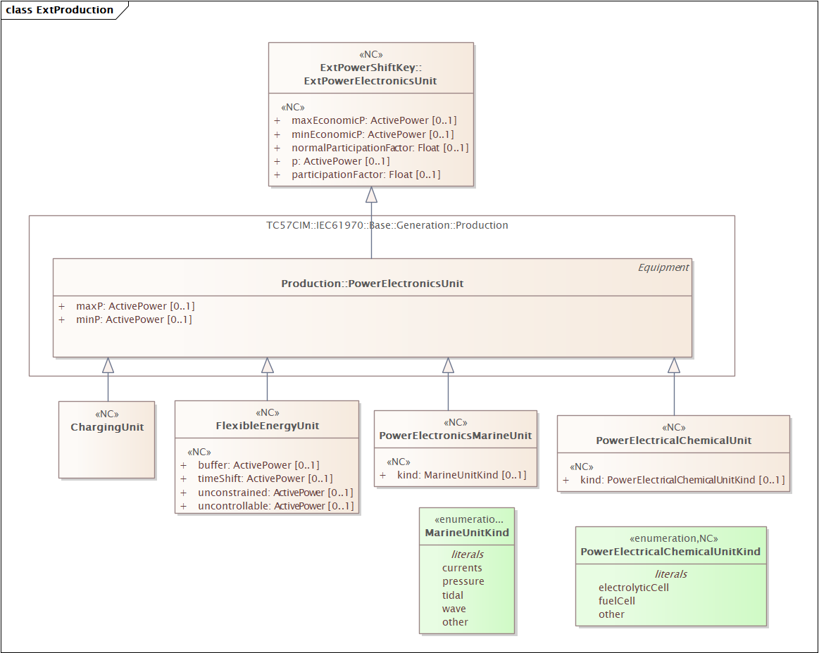

Slide 16
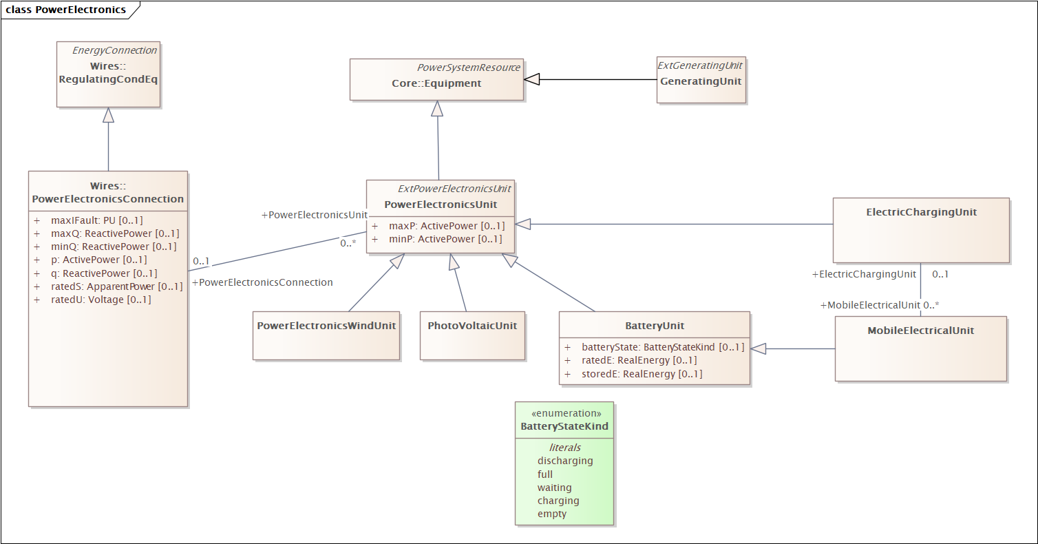

Slide 17
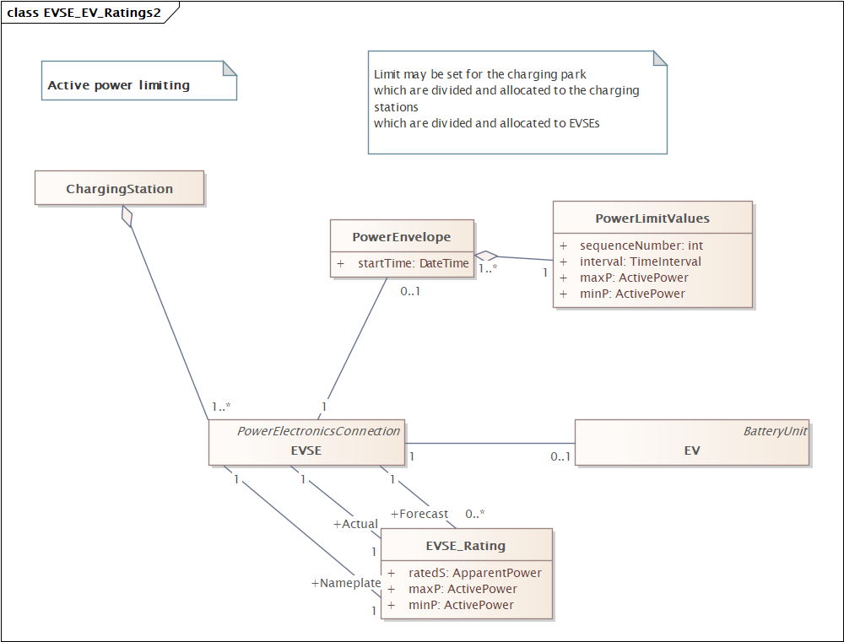
Power Limiting
Notes:
Diagram shows how power limits = an operating envelope could be associated with the EVSE
These diagrams show the basic framework considering active power.
For EV as DER in some places like California, there could be 30-40 parameters (as per IEEE 1547)
For model inspiration
See 15118-20
SAE J3072
IEC 63110 UML model
…
Need to add a property to indicate the capability
GridForming vs GridFollowing

