Slide 1
IEC 63382 Management of Distributed Energy Storage Systems based on Electrically Chargeable Vehicles Proposals for CIM extensions for electric vehicle charging
Author: Tom Berry
Representing: TC69 JWG15
Date: 11-June-2024

Slide 2
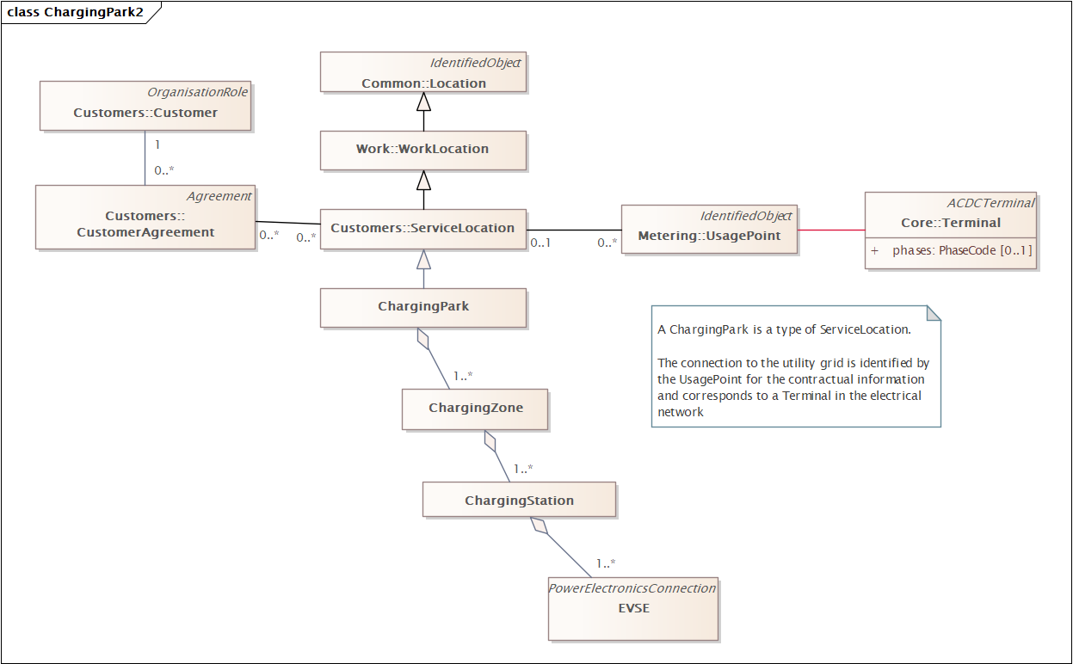
Charging Park and Contracts
A ChargingPark is a specialization of ServiceLocation
A small Park will have only one Zone

Slide 3
Definitions
Agreed last time
Charging Station
physical equipment consisting of one or more EV supply equipment managing the energy transfer to and from EVs. [IEC 63382-1]
Charging Park
geographical area that encloses one or more charging stations with one operator
[From : IEC 63110-1 and ISO]
Charging Zone
Power management concept representing a group of one or more charging stations within a particular charging park (typically with a relationship with the electrical arrangement)

Slide 4
Definitions
Agreed last time
Electric Vehicle Supply Equipment
EVSE
equipment or a combination of equipment, providing dedicated functions to supply electric energy from a fixed electrical installation or supply network to an EV for the purpose of charging and discharging
[SOURCE: IEC 61851-1:2017, 3.1.1, modified – The words "and discharging" have been added to the definition, and the examples have been removed.]
[IEC 63110-1] = to be used by IEC 63382

Slide 5
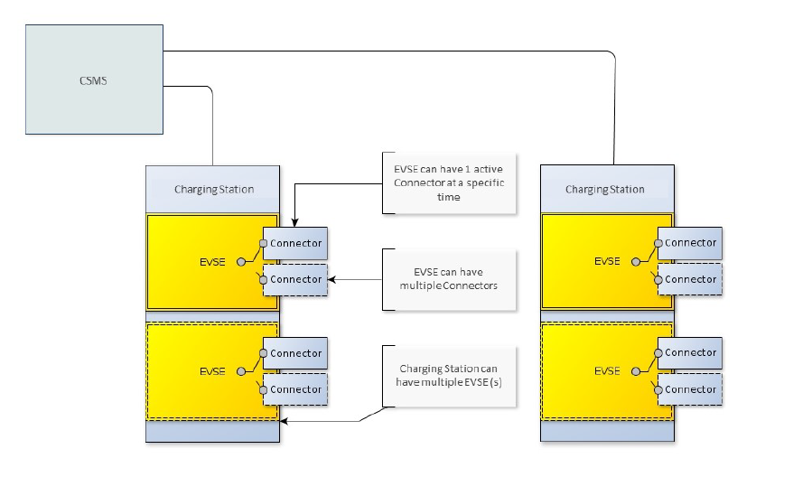
Background: definitions from OCPP
OCPP-2.0.1_part1_architecture_topology.pdf
Charging Station is the physical system where EVs can be charged.
A Charging Station can have one or more EVSEs (Electric Vehicle Supply Equipment).
An EVSE is considered as a part of the Charging Station that can deliver energy to one EV at a time

Slide 6
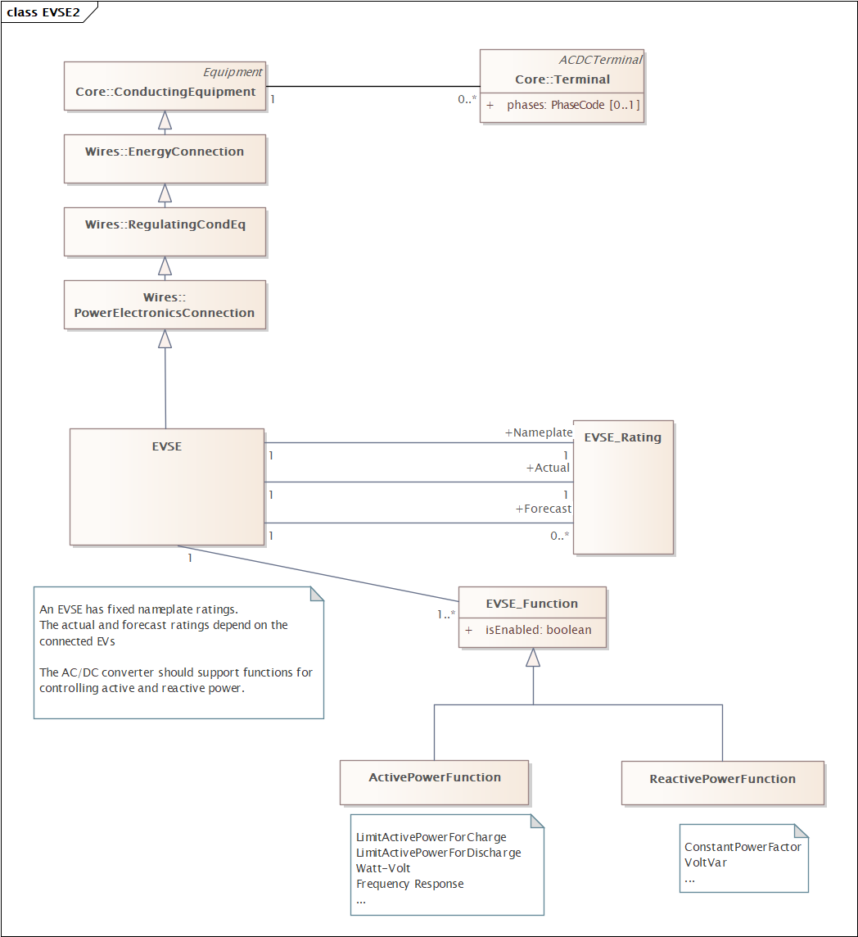
EVSE as DER
An EVSE is a special type of PowerElectronicsConnection
It will have ratings that depend on the connected EV
The control functions may have settings
Fixed by grid codes
Communicated from the DSO via the CSMS
To do : add EVSE type information

Slide 7
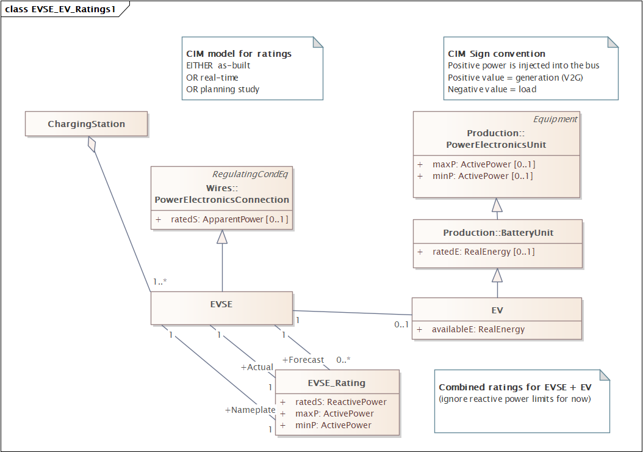
Ratings for EVSE + EV
Notes:
Modelling concepts that extend the utility control center Common Information Model (CIM)
As used for utility planning and markets.
Many of properties have equivalents in IEC 61850 models.
Mapping them to IEC 61850 models will be done later.

Slide 8
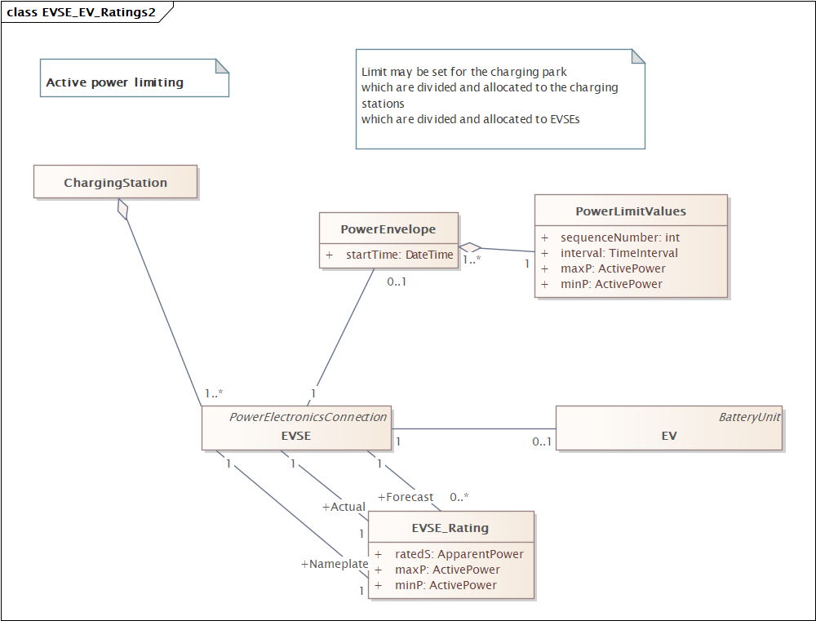
Power Limiting
Notes:
Diagram shows how power limits = an operating envelope could be associated with the EVSE
These diagrams show the basic framework considering active power.
For EV as DER in some places like California, there could be 30-40 parameters (as per IEEE 1547)
For model inspiration
See 15118-20
SAE J3072
IEC 63110 UML model
…
Need to add a property to indicate the capability
GridForming vs GridFollowing

