Slide 1
Tap changer issues – Redmine issue 6452

Slide 2
Content
Multiple RatioTapChanger on a winding
Request to have Phase and Ratio tap change table and switch between them
Transformer with changeable winding connection angle
Change all impedances of equivalent circuit of transformer when changing a tap changer on a winding
Different apparent power limit depending on tap changer steps
Inconsistencies -301/-452
Transformers with more than 3 windings

Slide 3
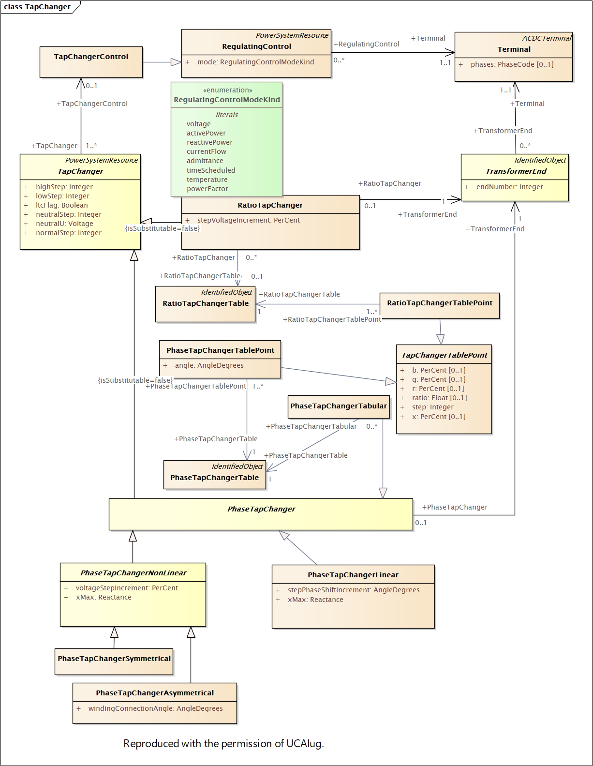

Slide 5
Request to allow Multiple tables
The possibility to have both a PhaseTapChangerTable and a RatioTapChangerTable assigned to a TapChanger in EQ and an attribute in SSH to denote which is active

Slide 6
Phase and Ratio tap change on same winding – The problem
There are many transformers that have the following characteristics
Tap changer has steps 1 to 27, neutral is step 14
Winding connection angle is switchable +(60°), -(-60°), (0°). 0 deg models ratio tap change – voltage regulation; -60 deg and +60 deg model phase tap change – power regulation
Switching of winding connection angle happens on load when the tap is at neutral position
Tap changer is capable to change taps on load
Operational practice is that the winding connection angle is changed relatively often (it could be every day or within a week, i.e. nothing too stable)
There is no automatic control on these transformers

Slide 7
Phase and Ratio tap change on same winding – The problem
Current CIM based data exchange (both CGMES v2.4 and CGMES v3) prevent exact modelling
It is not possible to model the behaviour in a table as the table does not include information on the winding connection angle
In essence the tap changer is neither RatioTapChanger nor PhaseTapChanger
Winding connection angle with 0 deg triggers a violation as 0 deg in not allowed for phase tap changer.
In order to model the behaviour adequately the sending party needs to update Equipment dataset every time there is a change in the winding connection angle
There is no way to have both RatioTapChanger and PhaseTapChanger and activate one of them

Slide 8
Short-term options (before standard is updated)
For all short-term options new EQ dataset is necessary every time there is a change
Option 1: Accept that violation on winding connection angle = 0 deg is triggered
Option 2: Export PhaseTapChanger for +-60 deg and when it needs to be ratio (0 deg) export RatioTapChanger
Option 3: Two tap changers are modelled one PhaseTapChanger and another RatioTapChanger. The switch between PhaseTapChanger and RatioTapChanger is done by setting up respected tap changer in neutral step so that there is no phase or ratio effect
All options have drawbacks and interoperability is in question

Slide 9
Long-term options
Option 1: Rename windingConnectionAngle to normalWindingConnectionAngle in EQ profile. Add windingConnectionAngle in SSH profile.
Option 2 (not preferred): Allowing multiple tap changers and have option to activate them in SSH
Option 3 (preferred): Add new type of tap changer that has switchable winding connection angle. Basically, apply Option 1 on a new type of type changer.
Option 4 (preferred): Add another table option to include the winding connection angle in the table or define way to use different tables for different winding angles

Slide 10
Proposal for discussion to cover the 3 problems
Change the cardinality of TransformerEnd.RatioTapChanger from 0..1 to 0..2. This will solve the 1st part
Rename windingConnectionAngle to normalWindingConnectionAngle in EQ profile. Add windingConnectionAngle in SSH profile. This will allow PhaseTapChangerAsymetrical to change angles, but still keep the rule 0 deg and 180 deg not allowed as this will represent another type
Add Boolean .normalEnabled (in EQ) and .enabled (in SSH) on the TapChanger so that we have possibility to activate tap changers
Add new type of tap changer that has switchable winding connection angle where we allow 0 deg
Add another table option to include the winding connection angle in the table or define way to use different tables for different winding angles. Perhaps this is something we already have with PhaseTapChangerTablePoint, but can the angle there be 0? Can a phase tap changer table represent ratio tap changer. The semantics might be not ok and this is why perhaps better to have TapChangerTabular that can do Phase and Ratio. Perhaps we need enabled flag on the Table and clarify if a tap changer control controls across all tables or not.

Slide 11
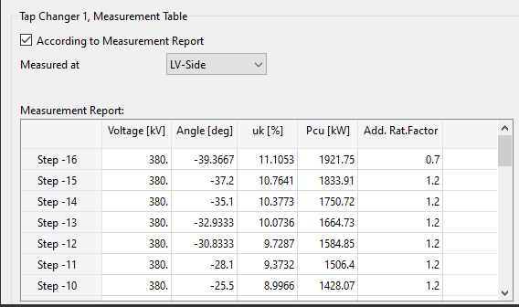
Phase-shifting transformers have a limit on apparent power at extreme taps
Screenshot illustrates how this is modelled in power system analysis application
Solution could be to add the additional information to the table point

Slide 12
Statements in 301
Statement 1:” The PowerTransformerEnd and its connected Terminal both have sequence numbers TransformerEnd.endNumber and ACDCTerminal.sequenceNumber. Those numbers may or may not be in synch.”
Why do we not want to align between TransformerEnd.endNumber and ACDCTerminal.sequenceNumber?
Or can we actually get rig of TransformerEnd.endNumber and use ACDCTerminal.sequenceNumber instead?
Need to check consistencies
“Multiple tap changers can be combined within one power transformer, but to avoid interpretation issues only one phase shifting and one ratio changing tap changer shall be modelled on any given terminal. The ratio or phase shift change is documented relative to the other terminal(s) assuming those terminals are at the nominal (1 PU) ratio and nominal (zero) phase angle shift. Tabular representation is required in cases where it is necessary to combine both phase shifting and ratio tap changer on one terminal, as it conveys the explicit values of the resulting phases and angles.
Tabular representations for both ratio and phase shifting transformers can be used where the available CIM models do not appropriately reflect the physical behaviour. The tabular models are optional to the other CIM tap models. Tabular models may be used to describe the change in impedance through the tap range.
”

Slide 13
Statements in 301
Need to check consistencies
“4.6.7.2 Voltage ratio transformer modelling
The RatioTapChanger class is used to define a transformer tap that changes the voltage magnitude ratio without changing the phase angle across the transformer. A RatioTapChanger may be used in cases where the transformer inherently introduces a fixed phase shift, such as from a wye-delta winding connection.
4.6.7.3 Voltage ratio transformer tabular modelling
A RatioTapChangerTabular may be optionally associated to any RatioTapChanger and may represent a non-linear relationship between tap number, tap ratio, and impedances. If associated, the tabular ratio model takes precedence.
4.6.7.4 Linear phase shifter transformer modelling
A phase shifting transformer is linear if the phase shift increment per tap step is uniform and the voltage magnitude is constant over the full range of the tap changer. A linear phase shifter is modelled using the PhaseTapChangerLinear class.
4.6.7.5 Symmetrical and asymmetrical phase shifter modelling
…
It is highly recommended to use tabular data to exchange PST parameters (cim:PhaseTapChangerTabular) instead of having to recalculate the parameters per tap according to each model type.”

Slide 14
Statements in 452
“Additional requirements related to transformer modelling are listed below.
• Each PowerTransformer shall have at least two and no more than three PowerTransformerEnds.
• Each PowerTransformerEnd can have at most one tap changer (RatioTapChanger, PhaseTapChangerLinear, PhaseTapChangerSymmetrical, or PhaseTapChangerAsymmetrical). If a PowerTransformerEnd does not have an associated tap changer, the end should be considered to have a fixed tap.
Multiple types of regulating transformers are supported by the CIM model. Depending on the regulation capabilities, the effects of tap movement will be defined using the RatioTapChanger class, PhaseTapChangerLinear class, PhaseTapChangerSymmetrical class, or PhaseTapChangerAsymmetrical class. Each of these classes are subtypes of the TapChanger class. The use of the various subtypes is explained in IEC 61970-301”

Slide 15
Different impedance data of 3-winding transformer when changing one TapChanger
Assumed equivalent circuit model – nearly the same as in 301

Slide 16
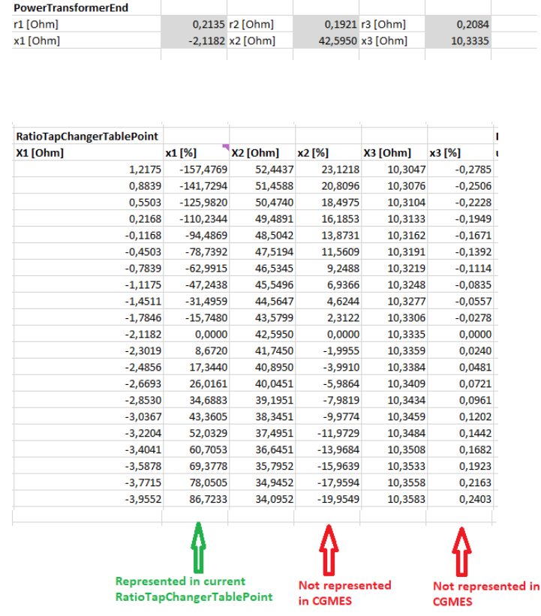
Different impedance data of 3-winding transformer when changing one TapChanger
To represent the model correctly we need to provide the equivalent parameters r1, r2, r3, x1, x2, x3 in all steps. The RatioTapChangerTablePoint can be used to represent the parameters in the individual steps. As an example, for one of our offshore trafos the equivalent parameters for all steps would be as follows: (only the x values are written here)
What is the solution to represent all parameters including x2 and x3. We see we can have only 1 RatioTapChangerTable that points to a RatioTapChanger. We would eventually need 3 RatioTapChangerTable pointing to the same RatioTapChanger to have an appropriate representation of the transformer parameters x1, x2 and x3 (and r too) in all steps.

Slide 17
Transformers with more than 3 windings
Transformers with 4 windings and more start to appear in the transmission grid. Information from UK – National Grid
Need to see how to accommodate this.
We need to gather more information, eventually update 301 and 452

