Slide 1
Tap changer issues – Redmine issue 6452

Slide 2
Content
Multiple RatioTapChanger in winding
Request to have Phase and Ratio tap change table and switch between them
Transformer with changeable winding connection angle

Slide 3
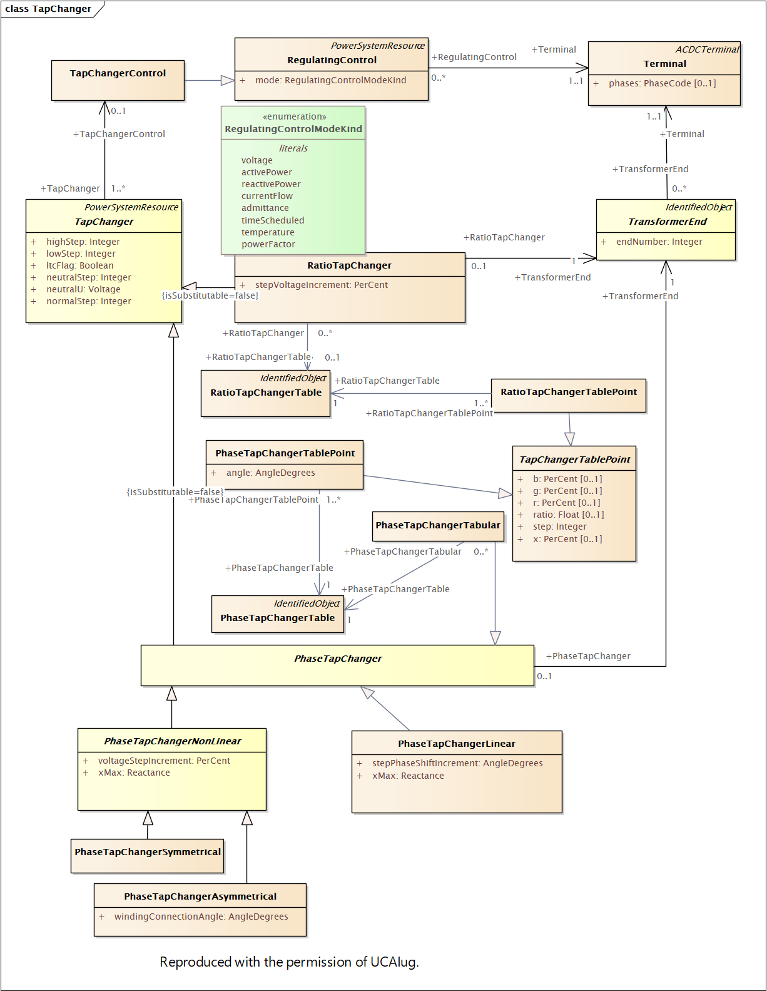

Slide 4
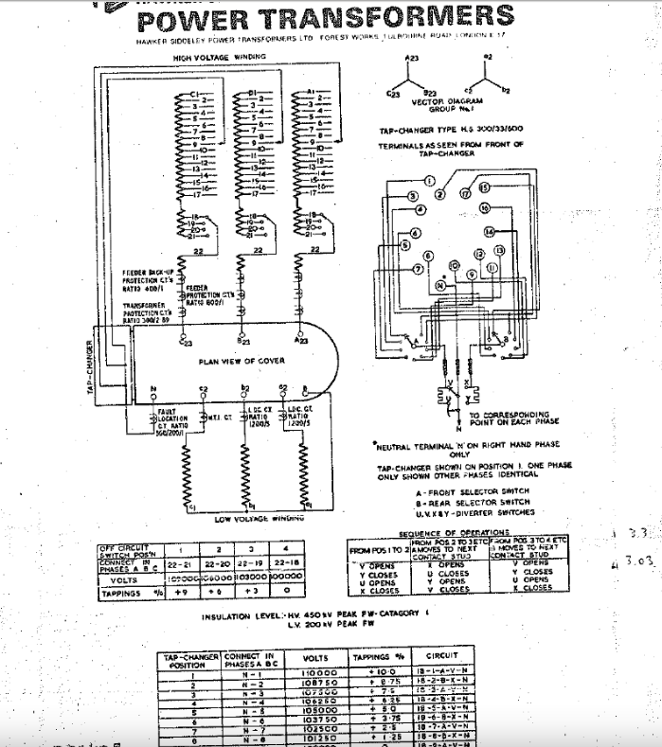
Multiple Ration Tap Changers
The current cardinality only allows one RatioTapChanger to be associated to a PowerTransformerEnd.
There are transformers which have two RatioTapChanger on one PowerTransformerEnd, one of which is on-load tap changer and the other one is off-load tap changer.

Slide 5
Request to allow Multiple tables
The possibility to have both a PhaseTapChangerTable and a RatioTapChangerTable assigned to a TapChanger in EQ and an attribute in SSH to denote which is active

Slide 6
Phase and Ratio tap change on same winding – The problem
There are many transformers that have the following characteristics
Tap changer has steps 1 to 27, neutral is step 14
Winding connection angle is switchable +(60°), -(-60°), (0°). 0 deg models ratio tap change – voltage regulation; -60 deg and +60 deg model phase tap change – power regulation
Switching of winding connection angle happens on load when the tap is at neutral position
Tap changer is capable to change taps on load
Operational practice is that the winding connection angle is changed relatively often (it could be every day or within a week, i.e. nothing too stable)
There is no automatic control on these transformers

Slide 7
Phase and Ratio tap change on same winding – The problem
Current CIM based data exchange (both CGMES v2.4 and CGMES v3) prevent exact modelling
It is not possible to model the behaviour in a table as the table does not include information on the winding connection angle
In essence the tap changer is neither RatioTapChanger nor PhaseTapChanger
Winding connection angle with 0 deg triggers a violation as 0 deg in not allowed for phase tap changer.
In order to model the behaviour adequately the sending party needs to update Equipment dataset every time there is a change in the winding connection angle
There is no way to have both RatioTapChanger and PhaseTapChanger and activate one of them

Slide 8
Short-term options (before standard is updated)
For all short-term options new EQ dataset is necessary every time there is a change
Option 1: Accept that violation on winding connection angle = 0 deg is triggered
Option 2: Export PhaseTapChanger for +-60 deg and when it needs to be ratio (0 deg) export RatioTapChanger
Option 3: Two tap changers are modelled one PhaseTapChanger and another RatioTapChanger. The switch between PhaseTapChanger and RatioTapChanger is done by setting up respected tap changer in neutral step so that there is no phase or ratio effect
All options have drawbacks and interoperability is in question

Slide 9
Long-term options
Option 1: Rename windingConnectionAngle to normalWindingConnectionAngle in EQ profile. Add windingConnectionAngle in SSH profile.
Option 2 (not preferred): Allowing multiple tap changers and have option to activate them in SSH
Option 3 (preferred): Add new type of tap changer that has switchable winding connection angle. Basically, apply Option 1 on a new type of type changer.
Option 4 (preferred): Add another table option to include the winding connection angle in the table or define way to use different tables for different winding angles

Slide 10
Proposal for discussion to cover the 3 problems
Change the cardinality of TransformerEnd.RatioTapChanger from 0..1 to 0..2. This will solve the 1st part
Rename windingConnectionAngle to normalWindingConnectionAngle in EQ profile. Add windingConnectionAngle in SSH profile. This will allow PhaseTapChangerAsymetrical to change angles, but still keep the rule 0 deg and 180 deg not allowed as this will represent another type
Add Boolean .normalEnabled (in EQ) and .enabled (in SSH) on the TapChanger so that we have possibility to activate tap changers
Add new type of tap changer that has switchable winding connection angle where we allow 0 deg
Add another table option to include the winding connection angle in the table or define way to use different tables for different winding angles. Perhaps this is something we already have with PhaseTapChangerTablePoint, but can the angle there be 0? Can a phase tap changer table represent ratio tap changer. The semantics might be not ok and this is why perhaps better to have TapChangerTabular that can do Phase and Ratio. Perhaps we need enabled flag on the Table and clarify if a tap changer control controls across all tables or not.

