Slide 1
Extensions handling
Joint discussion 23 Oct 2023, Minneapolis

Slide 2
Background
Agreement taken in Oslo, June 2023 to merge various extensions in CIM18v06. This results in multiple inheritance for extended classes, which appears to be a blocking issue for model Merge with TF14 and TF16
The root cause of the issue is how extensions are done and not why extensions are present
The extension approach used now is not new – it is used since 2010
Extensions – there are European extensions that are in IEC 61970-301 as normative, there are other extensions in Inf that are work in progress

Slide 3
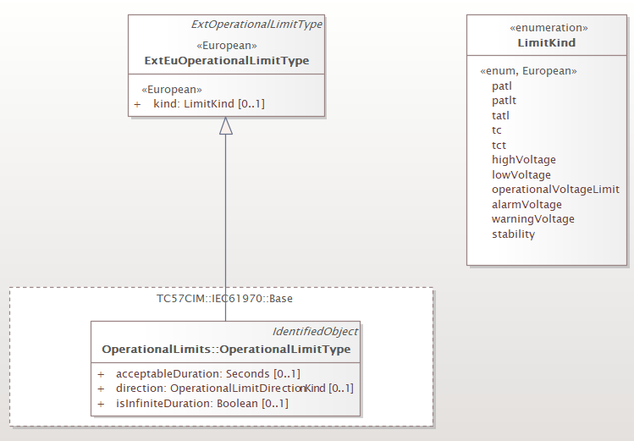
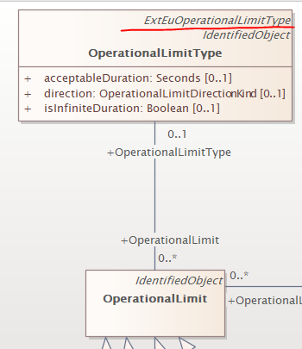
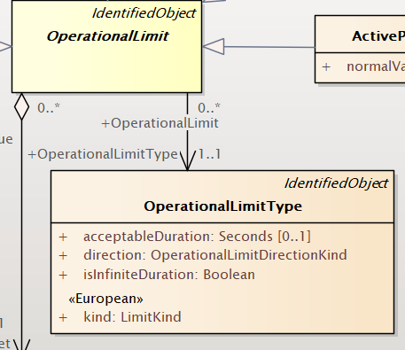
Different problems
Canonical – in the extended package
Issue 1 – Extensions modelling
Currently multiple inheritance is used in the canonical part
This is not visible in the profile – it is defined as profiling technique – rule
Advantage – it is very modular, helps model maintenance
Disadvantage – when printing documentation (Canonical-Base) the diagrams show multiple inheritance. Note there is no impact on tables as jCleanCim can filter on stereotype is set to do so
Any changes to way of extending have impact and this needs to be discussed
Profile
Canonical – in Base

Slide 4
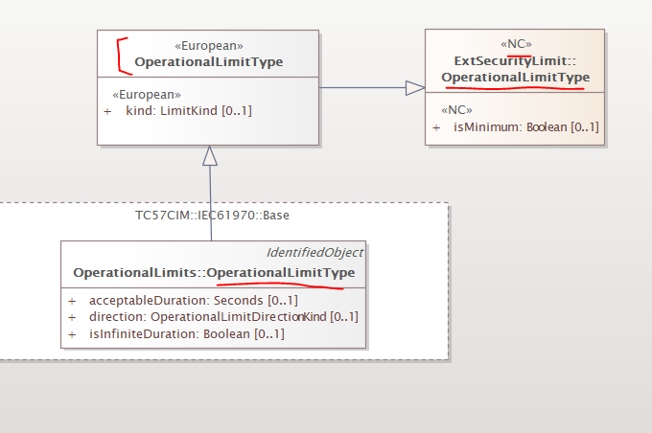
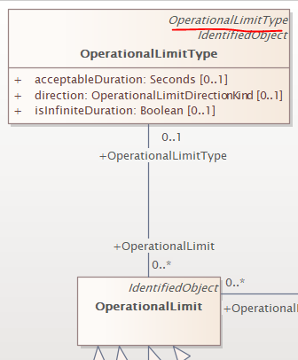
Different problems
Issue 2
Currently CMM guide says that we should not have classes with same name. In the past this was one of the main drivers to add Ext in front of the “normal” class name when doing the extension with multiple inheritance
However we have an issue #6355 which is decided, but not implemented. When we apply this issue we will have this situation – multiple inheritance will still show up but with same name; the CMM guide should be adapted to allow multiple classes with same name, but different namespace identified by the stereotype (if use the current way of doing this)
Canonical – in the extended package
Canonical – in Base

Slide 5
Different problems
Issue 3 – Maintenance
We want to have one EA file that includes all that is published in the standards and all that is for the future
We have at least 2 EA files – Only Canonical, Canonical and Profiles
In CIM17 we printed the extensions for 301 from the profile EA file, this is why they do not appear in the Canonical, but is this right?
How the mechanism for extending fits with the new UML maintenance – can we use some cloning or other techniques?

