Slide 1
Incorporating 61968-13 into 61970-45x
13 June 2023

Slide 2
Topics
61970-45x and 61968-13: The lay of the land
Why the existing picture is not optimal
Why we profile
How we profile
What could/should we do
Next steps

Slide 3
61970-45x and 61968-13: The lay of the land
We have 2 sets of profiles which describe subsets of the grid model portion of the CIM
One set was designed with transmission in mind, the other with a distribution perspective
They use the same approach (non-overlapping profiles, a single base profile)
This situation has resulted from the change in scope of WG13/14 from T/D to grid / support
Unfortunately the two profiles now describe different subsets of the underlying CIM information model (and one has lots of inconsistencies)

Slide 4
61970-45x and 61968-13: The lay of the land
Major differences
One represents the grid in a balanced fashion, the other represents it in an unbalanced manner
Which means there is/are
Duplication of classes, attributes and associations describing basic equipment, connectivity and containment
Additional phase-related classes in 61968-13
Different modelling of ratings and impedances

Slide 5
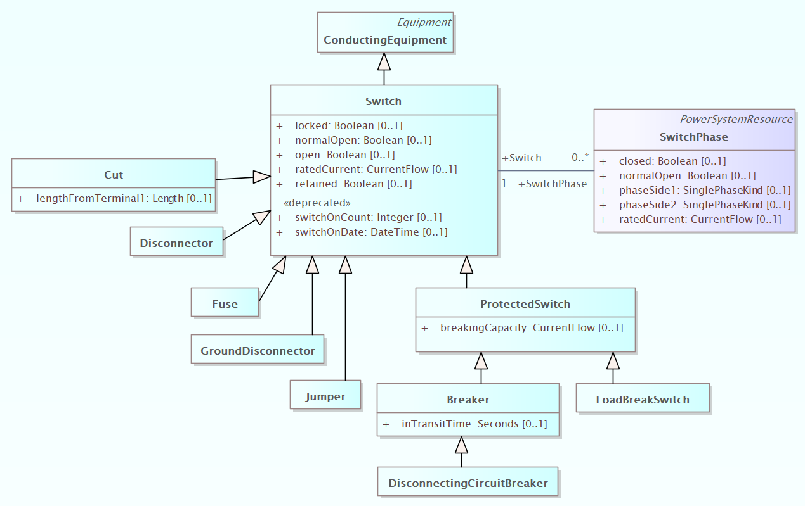
61970-45x and 61968-13: The lay of the land
balanced
duplicated
unbalanced
not used

Slide 6
61970-45x and 61968-13: The lay of the land
Major differences
One was developed with transmission application integration in mind, the other with distribution data exchanges in mind
This means that consuming applications had differing data requirements which led to the different dividing lines between profiles

Slide 7
61970-45x and 61968-13: The lay of the land

Slide 8
Why the existing picture is not optimal
Double maintenance for UCAIug TF/IEC WG – errors, inconsistencies, extra effort, extra time
Confusion and complexity for utilities
Distribution utilities are often responsible for subtransmission (and use balanced power flow tools) in addition to lower voltage networks (where they use unbalanced tools))
Data exchange across T and D is becoming a ubiquitous industry requirement (and some tool on one side or the other, needs to translate between balanced and unbalanced)
Messaging to industry (and education/training) is unnecessarily complex - it makes an already difficult ‘sales job’ much more difficult
Double work for vendors in interface development

Slide 9
Why do we profile?
To define the structure and meaning of a bounded set of information that is shared
For a given instance of exchanged data, a profile:
Supports validation of the defined set
Doesn’t say anything about information outside the defined set
Doesn’t require that objects of the defined set exist (other than by required associations)
When we define a standard profile, we are trying to enable interoperability
We talk about tool interfaces that ‘conform’ to a standard profile (and we talk about conformity certification)
There is an implication that the defined set of data can be read, validated and used as appropriate (“as appropriate” is fuzzy – if a tool clearly doesn’t use a particular type of data within the defined set, what does it need to do to conform?)

Slide 10
How do we profile?
In two parts
RDFS – provide the capabilities discussed above, easy to ‘see’ particularly when expressed in UML
Constraints – provide finer grained profile definition, support more detailed validation, currently very difficult to ‘see’ and maintain
Valid value ranges
Instance requirements
Complex cross-attribute, cross-class requirements relating to values, presence, number

Slide 11
Where do we go?
Can we define an approach that
Defines profiles that reflect consuming application needs across both T & D
Streamlines modelling and maintenance of balanced and unbalanced profiles

Slide 12
Profile divisions to meet consuming application needs
Our 61970-45x and 61968-13 profiles both ‘subdivide’ Physical grid model data into profiles by type of consumer

Slide 13
Profile divisions to meet consuming application needs

Slide 14
Model streamlining to support balanced and unbalanced
EQ
base profile
ConductingEquipment
+ normalOpen
+ lengthFromTerminal [0..1]
ProtectedSwitch

Slide 15
Model streamlining to support balanced and unbalanced
balanced EQ adder profile
ConductingEquipment
+ ratedCurrent [0..1]
+ retained
ProtectedSwitch
Breaker

Slide 16
Model streamlining to support balanced and unbalanced
unbalanced EQ adder profile
+ switchOnCount [0..1]
+ switchOnDate [0..1]
+ closed [0..1]
+ normalOpen [0..1]
+ phaseSide1 [0..1]
+ phaseSide2 [0..1]
Notes:
Switch.ratedCurrent is in ElectricalProperties profile
Switch.switchOnCount is <<deprecated>>in canonical UML
Switch.switchOnDate is <<deprecated>>in canonical UML
SwitchPhase.closed is erroneously in Functional
SwitchPhase.ratedCurrent is in ElectricalProperties

Slide 17
Agreement for moving forward
Have official, visible profiles for instance exchange (expressed in rdfs) – Physical, Situation, Solution, Asset, Asset Catalog, GeographicalLocation, DiagramLayout ^{1,2}
The Physical, Situation and Solution profiles are made up of sub-profiles that are managed as such in profiling tools (and have independent maintenance & versioning) and have independent sets of constraints defined.
Individual exchanges and vendor conformity can be specified at the sub-profile level.
1- acknowledge that the tank-based transformer modelling needs to be clarified to work in alignment with this
2- current proposal has only 4 rdfs level profiles – Physical, Situation, Solution, Diagram Layout

Slide 18
Agreement for moving forward
Standard numbering:
452 – Physical – Connectivity, non-Short Circuit & Short Circuit Electrical Parameters
456 – Situation and Solution
457 – Physical - Dynamics
453 – Diagram Layout
?add to 452? - Asset
?add to 452? - Asset Catalogue
?add to 452? – Geographical Location

Slide 19
Agreement for moving forward
 | Base | balanced | unbalanced
Solution (TP + SV) |  | x | x
Situation (SSH renamed) |  | x | x
Physical - dynamics
Physical - measurement
Physical - short circuit | x | x | to be checked
Physical - electrical | x | x | x
Physical - connectivity | x | x | x
Asset Catalog
Asset
DiagramLayout (DL)
GeographicalLocation (GL)

Slide 20
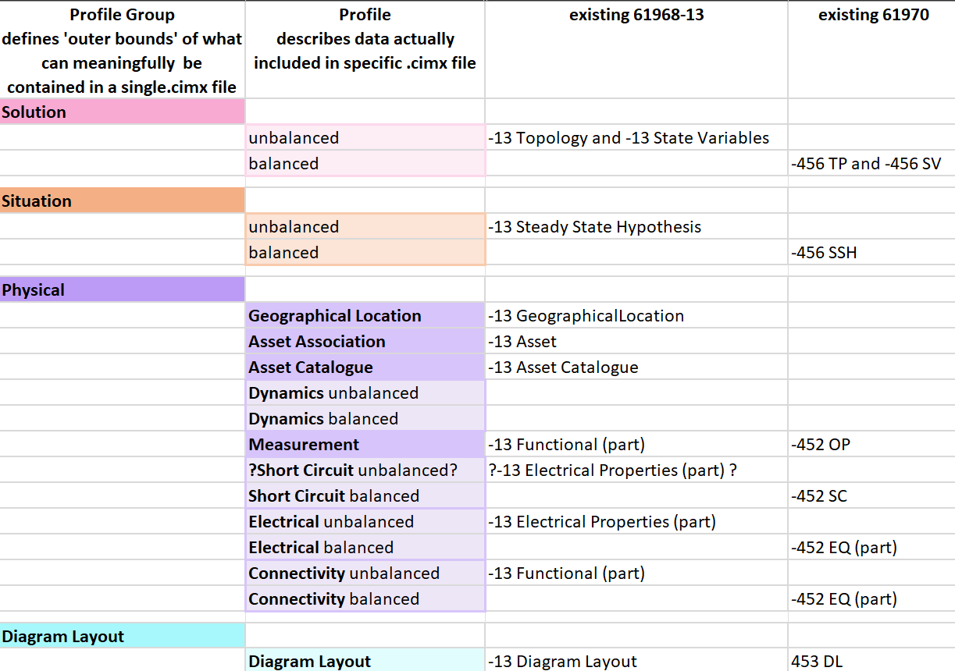
Agreement for moving forward – current proposal

