Slide 1
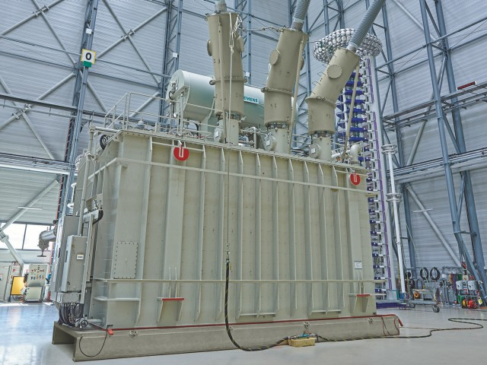
VSR – Variable Shunt Reactor Modeling

Slide 2
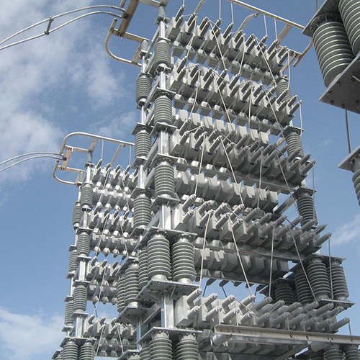
VSR Capacitor Banks

Slide 3
Variable Shunt Reactor
VSR is a Shunt Reactor with tap changer (same type used in power transformers)
Range is from 20% to 100% of maximal susceptance
It cannot have tap changer at 0 (a special breaker is assigned to deenergize VSR)

Slide 4
Resistance, Reactance per tap position - linear
R measured using small DC current through each coil Z measured using small AC current through each coil

Slide 5
1/Z=1/(R+jX)=G+jB=Y Admittance usually used for shunt model (I=YU)

Slide 6
Capacitor Banks

Slide 7
Capacitor Banks
A grouping of several capacitors
Sections start at 0 (goes from 0 to 100%)
Sections often equal (each section same G and B)

Slide 8
VSR Capacitor banks
Shunt reactor with tap changer
Usually linear for R, X
Starts at 1
First tap different value than difference between other taps
First tap can have maximum or minimum admittance
A grouping of capacitors
Usually linear for G, B
Starts at 0, 0 is implied
All sections equal usually
Each section adds more G and B

Slide 9
Current ShuntCompensator model suited for capacitor banks not for VSR

Slide 10
VSR as NonlinearShuntCompensator
Some vendors have implicit 0 sections (with G=0 and B=0)
Power flow calculations allow a choice of 0 section which VSR cannot execute
Optimal Power flow can suggest 0 sections
Voltage regulation simulation use 0 section

Slide 11
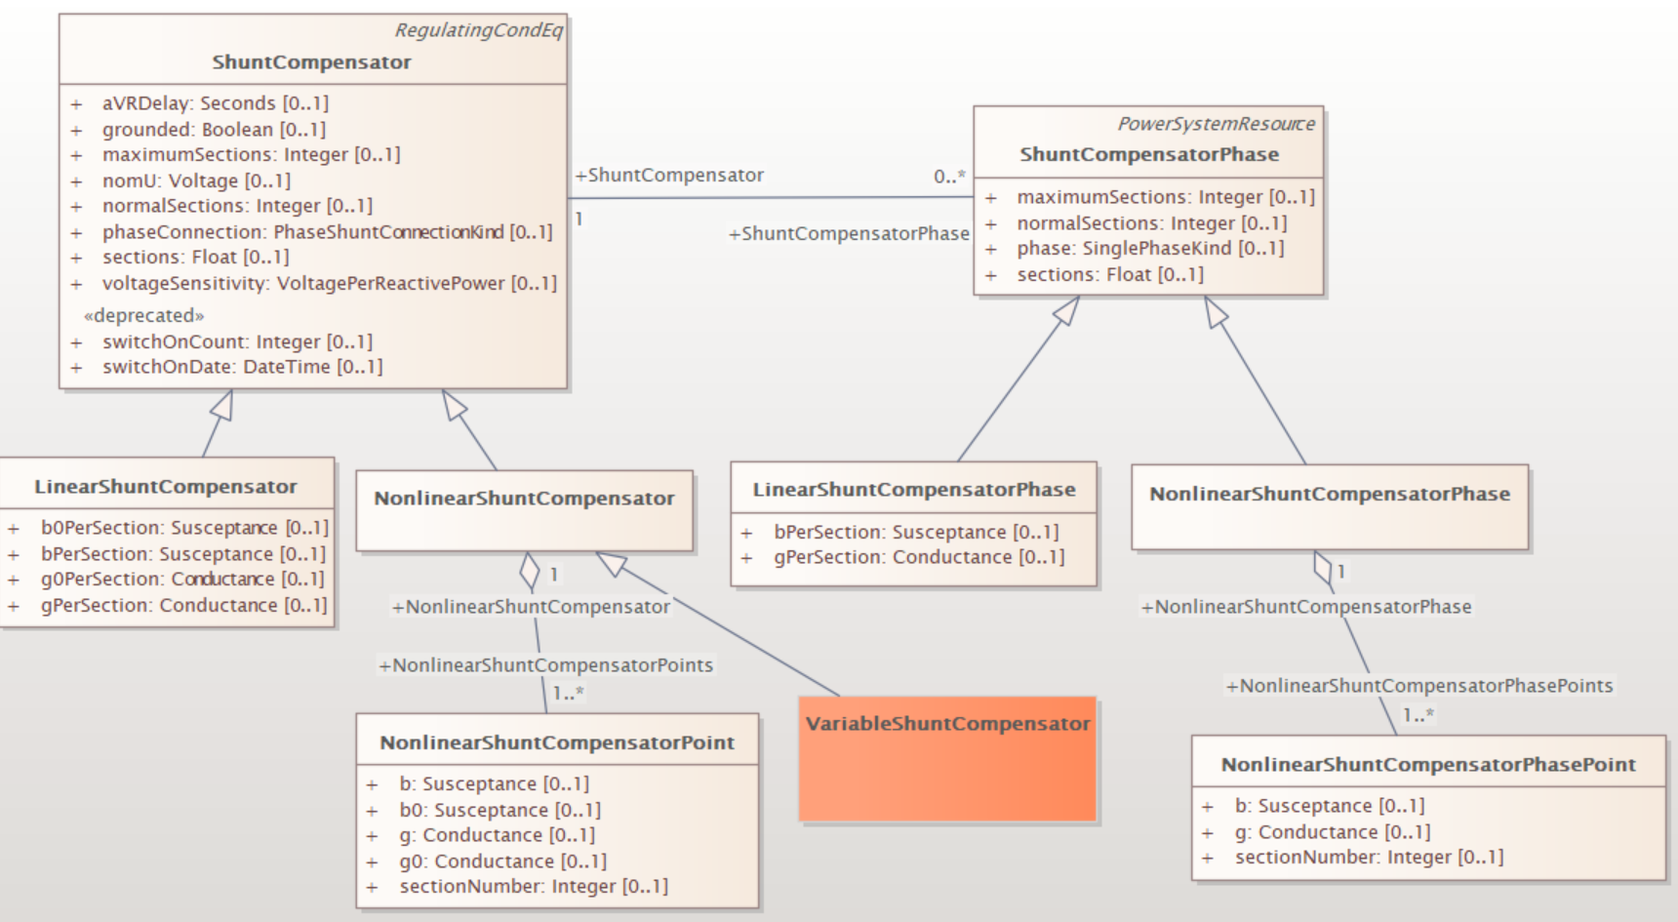
VSR as a specialization of NonlinearShuntCompensator
Note for VariableShuntCompensator would say: Variable shunt compensator sectionNumbers start at 1. 0 sectionNumber is not allowed.

Slide 12
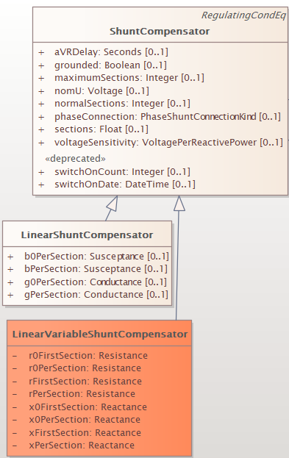
LinearVariableShuntCompensator
To model the linearity of VSR a R and X need to be used
This has no use for calculations because modeling of shunts use admittance (G+jB) – calculations would not see linearity
Recommend not to use linear model of VSR

Slide 13
Automatic regulation – no need to change

Slide 14
OPF calculations
two tier optimization
optimization in the range using taps (20%-100%)
to be used for real-time operation
optimization of energized status
for optimization of the several hours (days) ahead

Slide 15
Roadmap
To be a part of revisiting of SVC/STATCOM and looking into capacitor banks
Coordinate with Asset and AssetInfo
Topic for CIM 18

Slide 16
NonlinearShuntCompensatorPoint Note spelling error
A non linear shunt compensator bank or section admittance value. The number of NonlinearShuntCompensatorPoint instances associated with a NonlinearShuntCompensator shall be equal to ShuntCompensator.maximumSections. ShuntCompensator.sections shall only be set to one of the NonlinearShuntCompensatorPoint.sectionNumber. There is no interpolation between NonlinearShuntCompensatorPoint-s.

