Slide 1
CIM Issue Electrical Connection Point = Measurements and Meters
Tom Berry
V1: October 2021
V2: January 2022
V3: April 2022

Slide 2
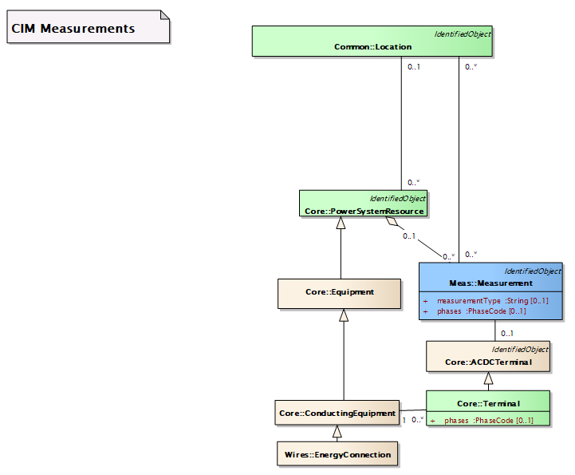
ECP: Measurements and Meters
As-is …
One IEC 61850 device – two choices for mapping
Via Measurement
Equipment and Terminal are explicitly defined

Slide 3
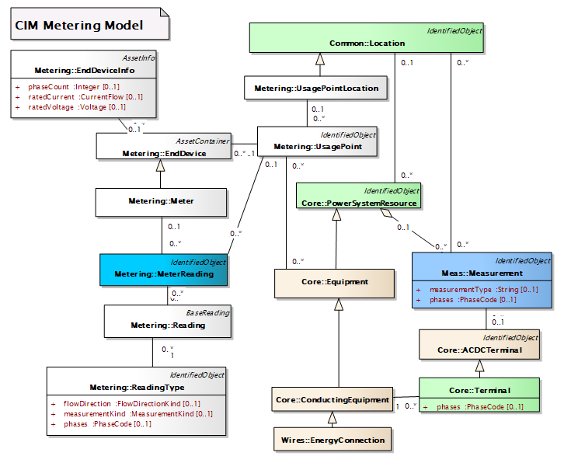
ECP: Measurements and Meters
As-is …
One IEC 61850 device – two choices for mapping
Via Metering Usage Point
Terminal is implied by associated Equipment
Unambiguous for EnergyConnection = DER
Ambiguous for branch devices (Campus)

Slide 4
ECP: Measurements and Meters
Proposal
One IEC 61850 device – two choices for mapping
Via Measurement
Equipment and Terminal are explicitly defined
Via Metering Usage Point
Proposal: use same associations as Measurement
Replace -> Equipment with
PowerSystemResource
Add
Terminal

Slide 5
Discussion (October 2021):
Association to terminal – broad agreement
Association to PSR instead of Equipment
this is for consistency with Measurements – you can have meter data for substations and bays
Related Issue- meters can have switch capability
This could be an Asset with 2 roles / functions : meter and switch
Is a meter conducting equipment? Ans. no its an Asset
What is a Usage Point?
= the “socket“ with location where a meter is “plugged in”
How is this related to Measurement sensors, CTs, PTs?
= currently these are modelled as Auxiliary Equipment

Slide 6
Can/should UsagePoint represent a Point of Connection?
Definition IEV 617-04-10
Area Organization/Market of electricity / Connection and supply
________________________________________
en point of connection
reference point on the electric power system where the user’s electrical facility is connected

Slide 7
[David Haynes] UsagePoint – some history
As-is …
In [IEC 61968] Part 9, there was a need to relate a revenue meter to a meter socket (or meter housing as the case may be.) The billing system needed to know this pairing but didn’t need much more than this.
Then we realized that there are non-metered loads in the utility which the billing system would care about (such as streetlights). We took the notion of a “service” connection and generalized it – calling it a “usage point.”
A generalized usage point could also feed utility-owned loads that are used to support the infrastructure.
One of the MDM vendors also realized that there might also be a use in identifying a “virtual” point on the line. They could use aggregated meter data to show all of the load downstream from a given point on the line, and maybe also compute an estimated voltage and current for this virtual point.

Slide 8
[Pat Brown] UsagePoint - the attributes imply it represents several roles
As-is …
a meter (or a meter role in a role-based model): amiBillingReady, checkBilling, readCycle, readRoute
a load in the grid model: estimatedLoad, minimalUsageExpected
a billed entity: isVirtual
grid modeling: nominalServiceVoltage, phaseCode, phaseCount, physicalConnectionCapacity, ratedCurrent, ratedPower
a point in the grid where operating responsibility changes: connectionCategory (though the description is odd), outageRegion
a customer: servicePriority

Slide 9
[Pat Brown] GMDM : PointOfCommonCoupling class
Proposal
A grid location (designated at a Terminal) at which grid operational responsibility changes. It often has associated with it:
Identity or contact information of the entity with operating responsibility on the non-utility side
Measured quantities or states (most common of which is power exchange)
Contractual commitments (for P, Q, V services)
Identification of facilities on the “other side” which are regulating some quantity at the PointOfCommonCoupling.
TB: Looks like a UsagePoint that emphasizes operational monitoring and control aspects that are already modelled with EndDevice

